Slide 1
Malaria and maritime traffic on the Colombian Pacific coast
Aimee R. Taylor
Diego F. Echeverry
Timothy J. Anderson
Daniel E. Neafsey
Caroline O. Buckee
Notes:
1. Hello everybody.
2. I’d like to start by thanking the organizers for giving me the opportunity to talk today.
3. I’m going to talk about Malaria and maritime traffic on the Colombian Pacific coast.

Slide 2
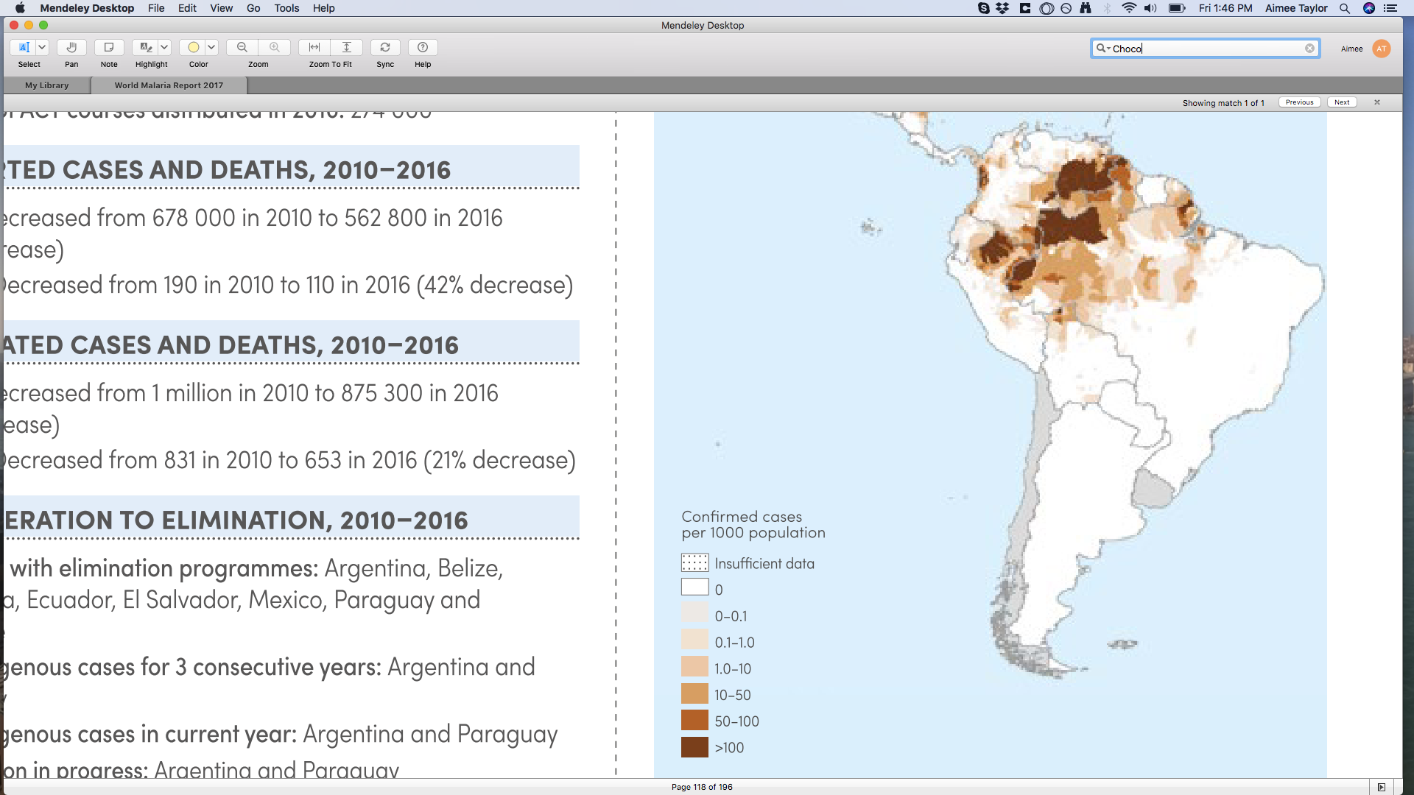
Malaria in Colombia
WHO World Malaria Report (2017)
Incidence almost halved between 2010-2016
Cases doubled from 2015 to 2016
More P. falciparum than P. vivax in 2016
Transmission is patchy; hotspot: Choco
In such heterogeneous transmission, targeted intervention requires knowledge of connectivity between malaria parasite populations:
Target isolated village
Success ✓
Notes:
1. Colombia has seen a huge reduction in malaria cases since 2010
2. But the case count in 2016 was twice that of 2015, with a majority of falciparum cases
3. Transmission is very patchy, with a hotspot of transmission in Choco
4. In such heterogeneous transmission, knowledge of connectivity between parasite populations is important for design of successful targeted interventions
5. With this in mind..,
------------------------------------
Illegal gold mining. Quibó (capital of Choco). Very rainy and bio diverse, but one of poorest places in Colombia. Many people and increasing looking for gold.
Diego went to Quidbó, river Atrató contaminated with gold slurry. Complete mess.
Evidence of heavy gold mining machinery from Brazil. Not sure how transported. Diego going to follow-up on possibility of river + road route: Brazil –> Laticia (Amazon capital) -> Choco
P. facliparum < P. Vivax in 2010, but P. Facliparum > P. Vivax in 2016

Slide 3
Research question and methods
Are malaria parasite populations connected on the Colombian Pacific coast and how?
Genetic relatedness between P. falciparum samples from the Colombian Pacific Coast
Notes:
1. We would like to know if malaria parasite population on the Colombian Pacific coast are connected and how using estimates of genetic relatedness between falciparum parasite samples.

Slide 4
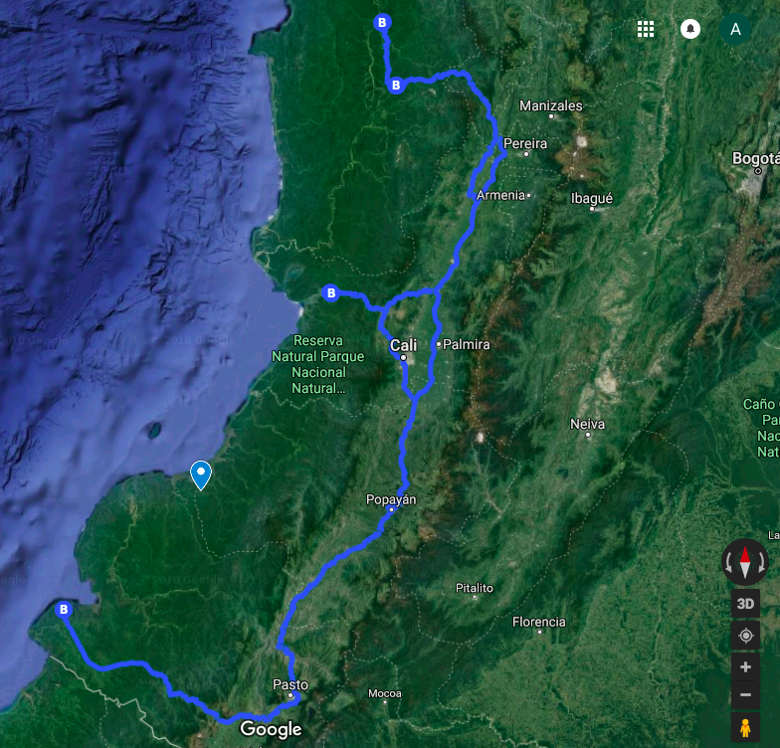
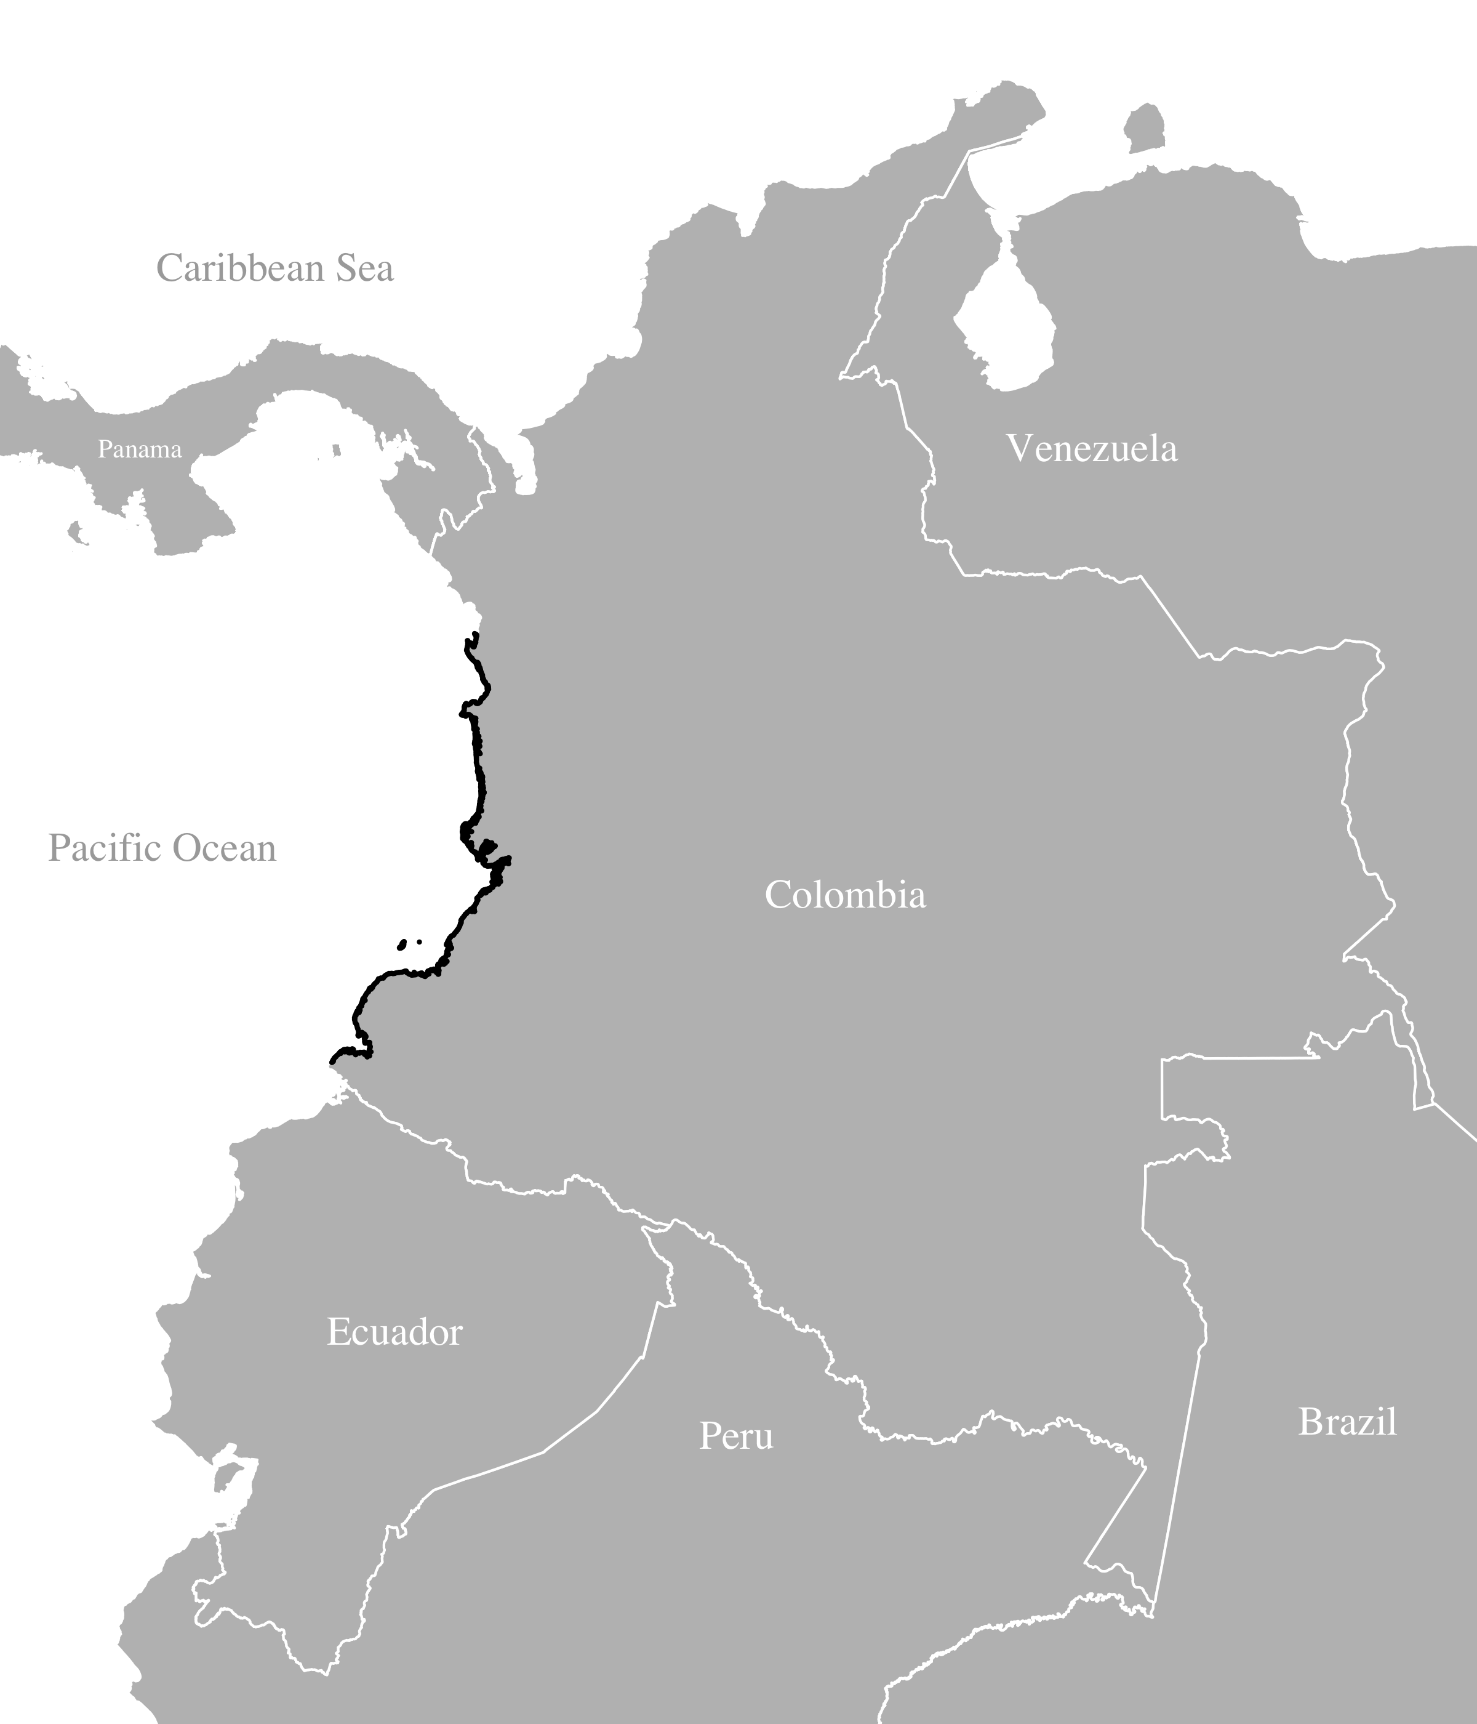
P. falciparum samples from the Colombian Pacific Coast
Quidbó 64 samples
325 single-genotype parasite samples collected from symptomatic cases between 1993 and 2007 and genotyped at 250 single nucleotide polymorphisms (SNPs)
Tadó 14 samples
Echeverry et al. (2013) BMC Genet.
Buenaventura 47 samples
Guapi 68 samples
Tumaco 132 samples
Notes:
The results I will present today were previously published by Diego Echeverry and collegues.
Over 80% of the samples originally collected were single genotype
In this study I’ll focus on those single-genotype samples, of which there are 325,
The samples were successfully genotyped at 250 SNPs
They were collected from 5 sites (shown here in yellow) on the Colombian Pacific coast (highlighted here) between 1993 and 2007
I’d like to draw your attention to the fact that Guapi is not accessible by road (shown here in blue), and is located between Tumaco and Buenaventura.
---------------------------------------------
Depending on place, prevalence of asymptomatic malaria estimated at 10% - 15% by PCR (skype with Diego, approx. 5 papers available)
Multiclonal: Choco (Quidbo and Tado, 25%); Buenaventura 14%: Valle; Guapi: Cauca 14%; Tumaco: Narino 19% (% MOI)
Collected to better understand the population structure of Colombian Plasmodium falciparum in preparation for genotype-phentotype studies of Colombian samples
Long term persistence of clonal malaria parasite Plasmodium falciparum lineages in the ColombianPacific region
Cases per 1000 inhabitants highest in Choco (10-20 cases per year) and Nariño (approx. 10) other < 5
"Colombia has approximately 100,000 malaria cases per year and >60%" of the population is at risk. Unstable transmission, all ages, mostly symptomatic.
Previous studies in Colombia have shown low genetic diversity, "low levels of multiclonal infections. 90% of population in the data-collaction region are Afro-Colombians.
A set of 384 SNPs were genotyped in blood spot DNA samples from 447 P. falciparum infected subjects collected over a ten year period from four provinces of the Colombian Pacific coast to evaluate clonality, population structure and linkage disequilibrium (LD). Most infections (81%) contained a single predominant clone. These clustered into 136 multilocus genotypes (MLGs), with 32% of MLGs recovered from multiple (2 – 28) independent subjects. We observed extremely low genotypic richness (R = 0.42) and long persistence of MLGs through time (median = 537 days, range = 1 – 2,997 days). There was a high probability (>5%) of sampling parasites from the same MLG in different subjects within 28 days, suggesting caution is needed when using genotyping methods to assess treatment success in clinical drug trials. Panmixia was rejected as four well differentiated subpopulations (FST = 0.084 - 0.279) were identified. These occurred sympatrically but varied in frequency within the four provinces. Linkage disequilibrium (LD) decayed more rapidly (r2 = 0.17 for markers <10 kb apart) than observed previously in South American samples.

Slide 5
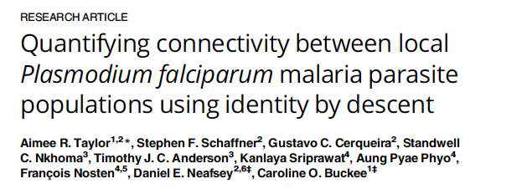
Genetic relatedness between malaria parasites
Genetic relatedness is a measure of ancestry broken down by recombination
Applicable to studies of malaria because malaria parasites sexually recombine
It reflects spatial temporal scales relevant for malaria control (Taylor et al. 2017)
Notes:
1. Genetic relatedness is a measure of shared ancestry broken down by recombination
Its applicable to studies of malaria because malaria parasites sexually recombine
Moreover, being recombination rate dependent if reflect spatial-temporal scales relevant for malaria control
As we should previously in this study of connectivity between parasite population on the Thai-Myanmar border

Slide 6
Estimates of genetic relatedness
Theoretically, genetic relatedness = probability of identity-by-descent
Practically, it can be estimated using genetic data and a probabilistic model
Various models exist for malaria: hmmIBD, isoRelate¹, DEploidIBD², polyIBD³
In this study, we use ﻿hmmIBD (Schaffner & Taylor et al. 2018)
Definition: alleles are identical-by-descent if descended from a common ancestor
Identical-by-decent
﻿﻿
¹ Henden, Lee, Mueller, Barry, & Bahlo (2018); ² Zhu, Hendry, Almagro-Garcia, Pearson, Amato, et al. (2018); ³ Poster number 1054, Session B (yesterday), Nicholas Brazeau
Notes:
Theoretically genetic relatedness is defined as a probability of identity by descent
Practically, it can be estimated from genetic data under a probablistic model
Various models have been developed for malaria parasite
In this study, we used hmmIBD

Slide 7
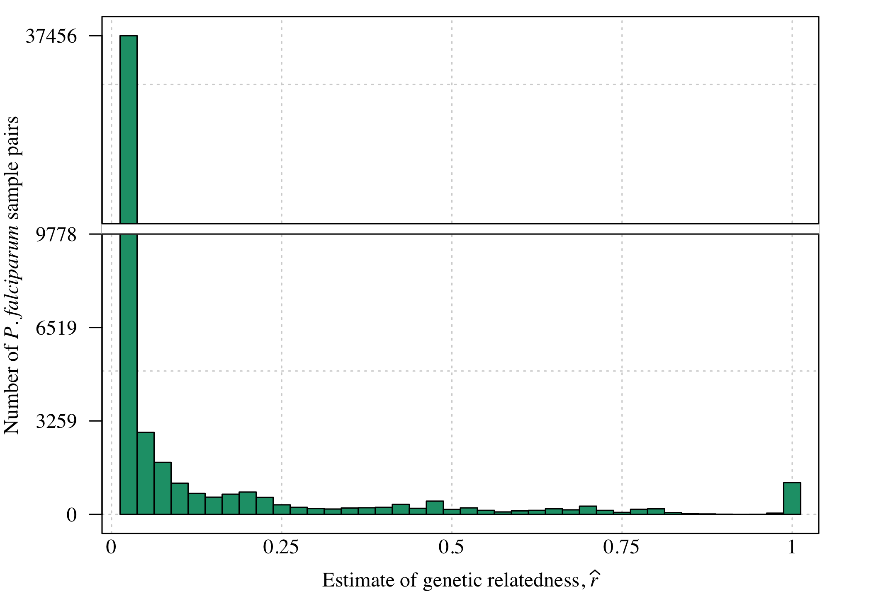
Estimates of relatedness between Colombian parasites
Notes:
This plot is a histogram of all relatedness estimates between all pairwise comparisons of the aforementioned parasite samples
The vast majority of sample pairs have very low relatedness, but some have high relatedness

Slide 8
Estimates of relatedness between Colombian parasites
estimate > 0.5 = “Highly related”
Notes:
For the purpose of this talk, I will refer to any estimate above 0.5 as highly related

Slide 9
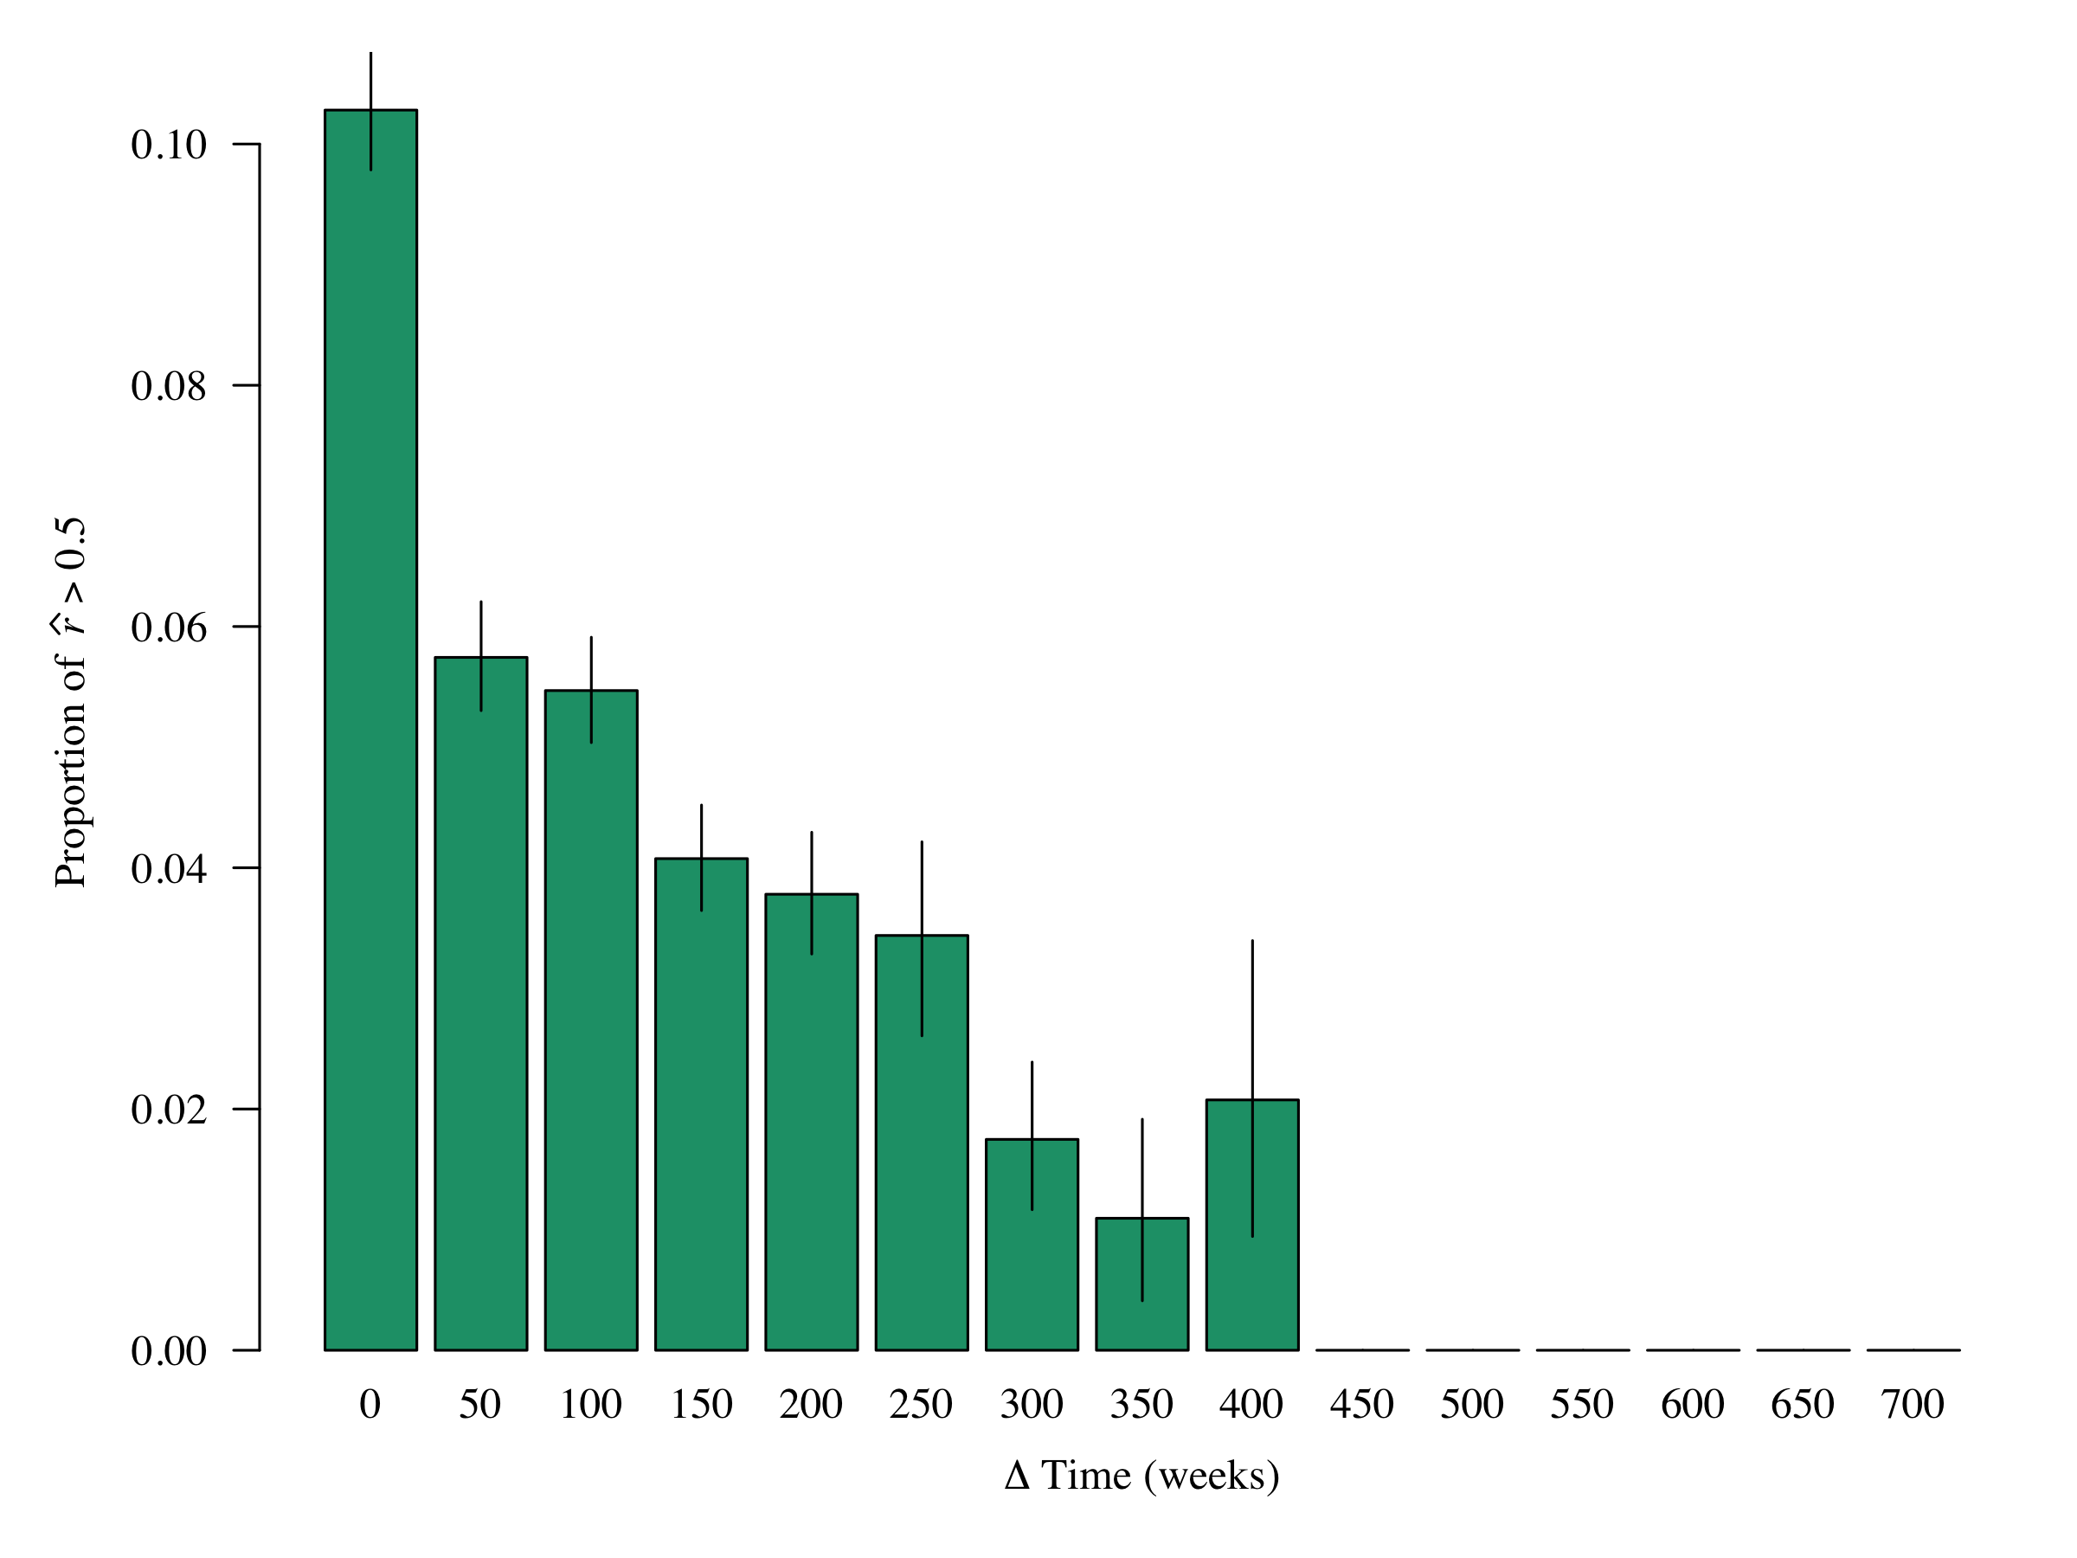
Greater relatedness when closer in time
Group estimates by Δ Time
Plot proportion of r estimates > 0.5 per Δ Time
Unpublished
Notes:
To visually explore trends relatedness over time
I grouped estimates by the time between their collection dates and plotted the proportion within each group that were highly related
For example, over 10% of sample pairs collected within the same week are highly related
Clearly samples collected closer in time are more related that sample collected far apart in time

Slide 10
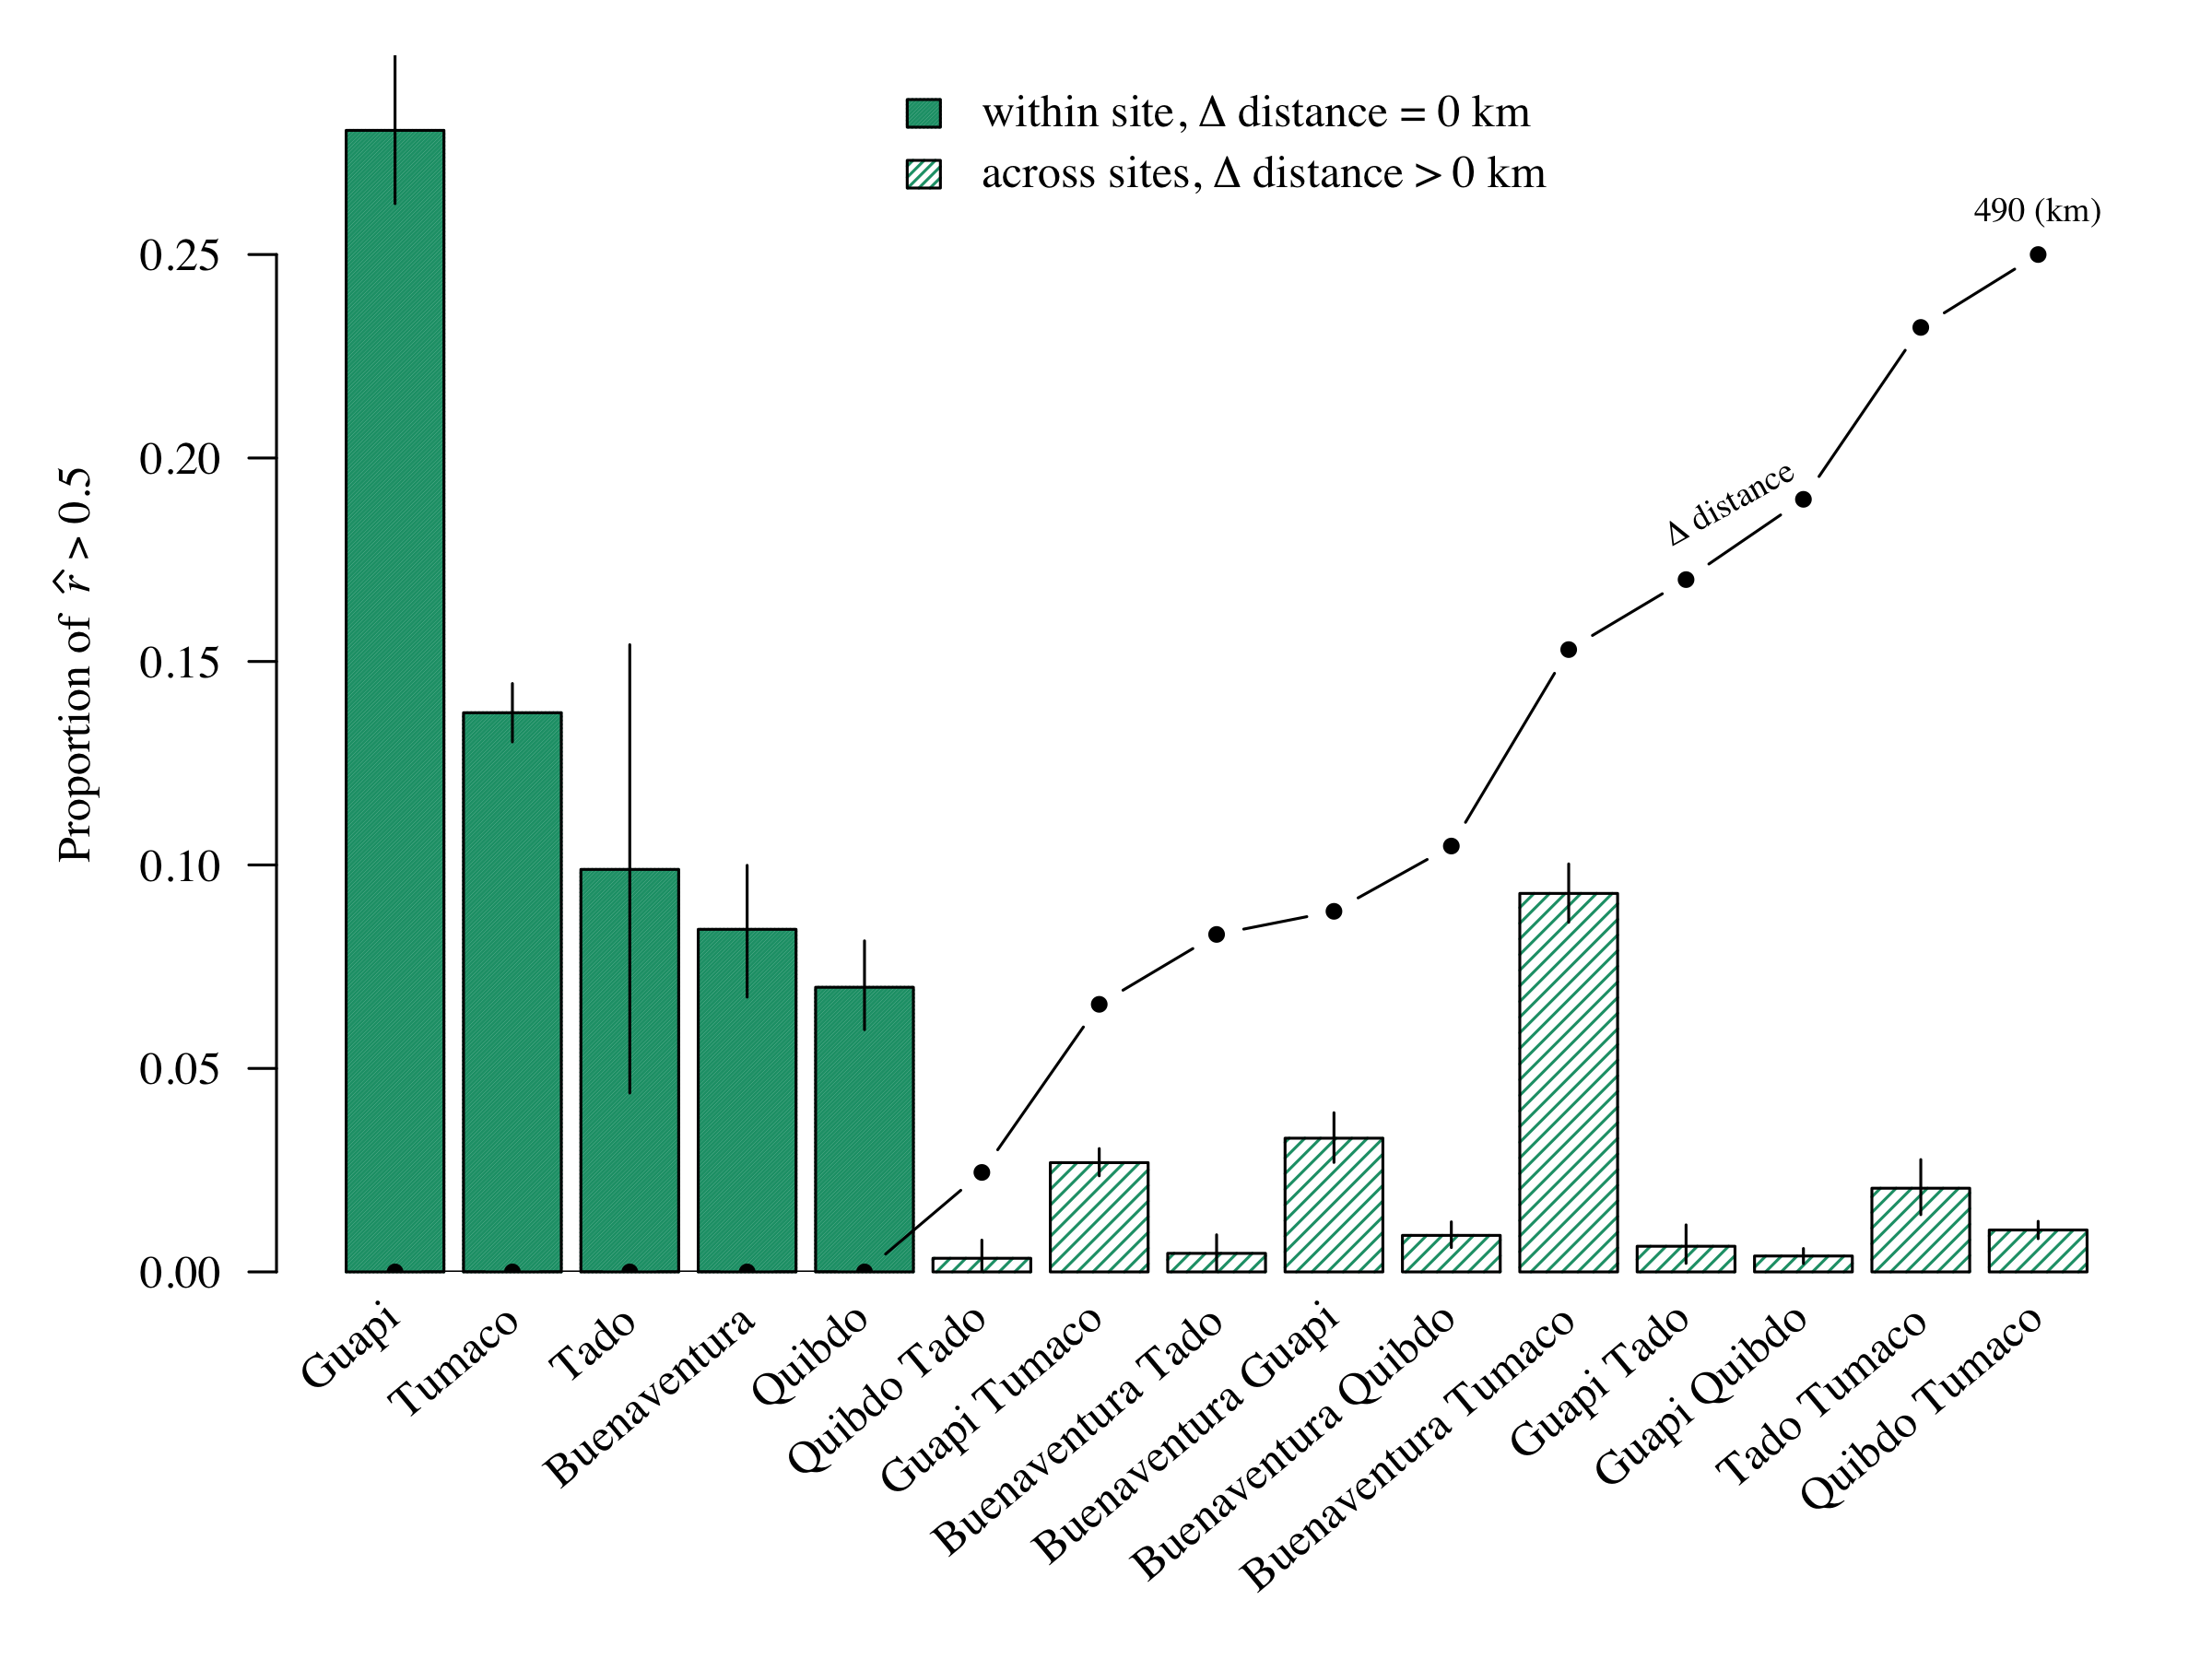
Greater relatedness within sites
Unpublished
Notes:
We can also group sample pairs, by collection sites and plot the proportion that are highly within and across sites
The line graph here shows the distance between sites, ranging from zero within sites to 490 km between Quidbo and Tumaco
In general, we see greater relatedness between samples collected from the same site versus different sites
The greatest relatedness is seen across samples from Guapi, as we might expect given Guapi’s isolation
The relatedness between samples collected in Buenaventura and Tumaco appears to be remarkable high, considering the geographic separation between these two sites
Given the previous slides showing the strong trend in relatedness over time, you might wonder if this is simply an artifact of time,
However, if we take each of these bars and partition by time

Slide 11
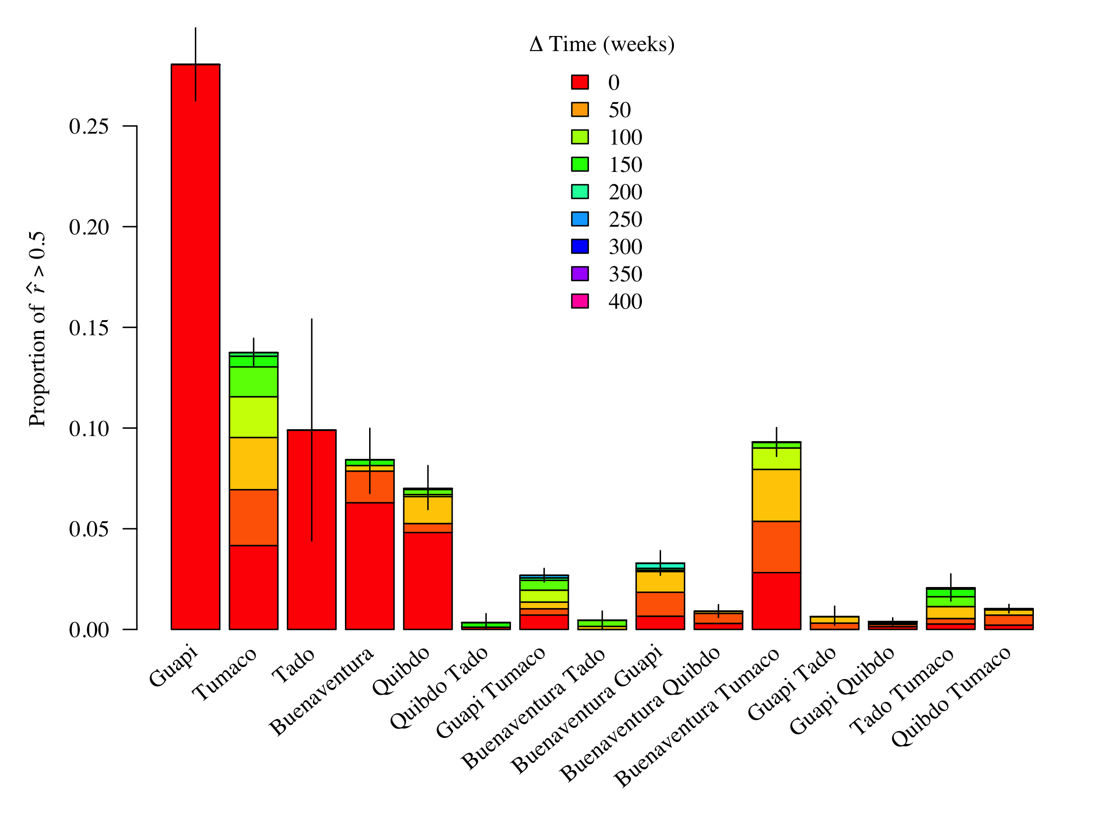
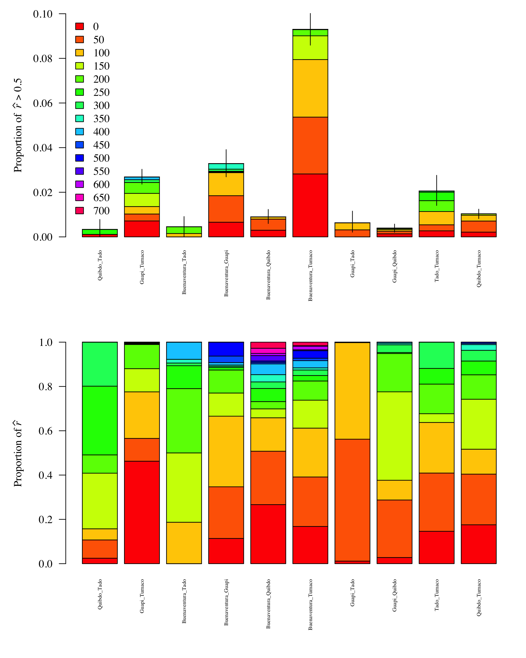
Is relatedness explained away by Δ Time = 0? No (not all bars are red)
Guapi: 66 of 68 samples collected in 2003
Tadó: 12 of 14 samples collected in 2001
Notes:
… shown here by the various colours
We see that, with the exception of Guapi and Tado, not all highly related sample pairs were collected at the same time
We might also wonder if highly related samples pairs are due to a single clone

Slide 12
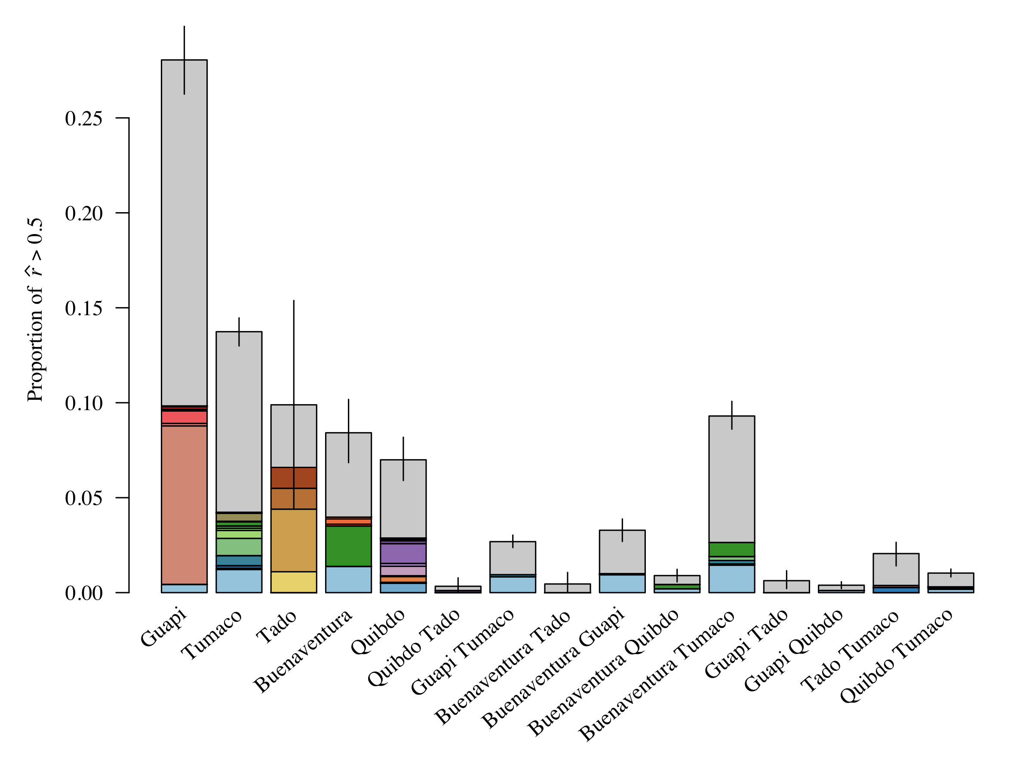
A closer look into the genetic links between ports
Is relatedness explained away by a single clone? No
Unique 250-SNP haplotype (r estimate < 1):
Repeat 250-SNP haplotype (r estimate = 1): etc.
Notes:
To explore this question we partition each bar by the 250-SNP haplotypes of the highly related sample pairs
The proportion of unique haplotypes is shown in gray
Each repeat haplotype is represented by a different color
This light blue haplotype is observed within and across several sites
But the vast majority of related parasite pairs are not characterized by a single clonal
-------------------------------------------------------
Remember all single-genotype
Allow four diff. Fuzzy matched because some IBD = 1 have IBS < 1
The fact that there are multiple repeat haplotypes suggests gene flow was not a one-time event. The fact that each site has some private repeat haplotypes suggests that there is potential for two-way flow.
The number of differently coloured repeat haplotypes might give a false impression of the number of independent pieces of information, however.

Slide 13
A closer look into the genetic links between ports
Is relatedness explained away by a single clone? No
Given that more than 80% of samples originally collected by Echeverry et al. were single-genotype, diversity is unlikely the result of a
one-time travel event across sites
Unique 250-SNP haplotype (r estimate < 1):
Repeat 250-SNP haplotype (r estimate = 1): etc.
Notes:
1. Given that the vast majority of samples originally collected by Diego Echeverry were signle-genotype, this level of diversity suggests connectivity between sites is not the result of a one-time travel event

Slide 14
A closer look into the genetic links between ports
Is connectivity explained away by a single clone? No
Unique 250-SNP haplotype (r estimate < 1):
Repeat 250-SNP haplotype (r estimate = 1): etc.
Next slide: plot as network
Notes:
In a bid to understand what might explain recurrent transmission between sites on the Colombian Pacific coast,
I’ll now focus on across-site comparisons, which we can visualize as a network on a map

Slide 15
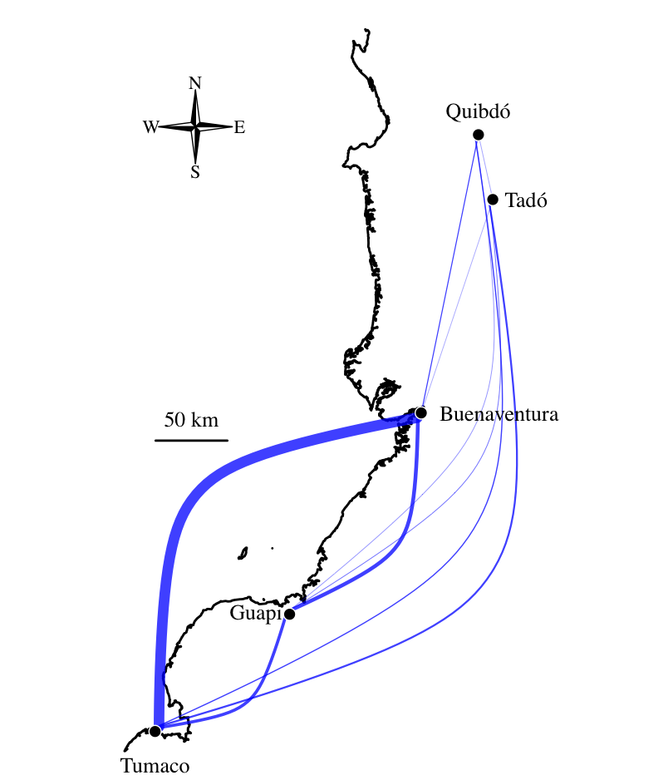
Genetic connectivity across sites
Unpublished
Width of blue edges corresponds to proportion of highly related parasites (i.e. height of across-site bars in previous slide)
Tumaco and Buenaventura are disproportionally connected
Notes:
As show here, where the width of these edges is proportional to the heights of the bars in the previous plot
The disproportional connection between Tumaco and Buenaventura is now very clear, raising the question of what might this connectivity?

Slide 16
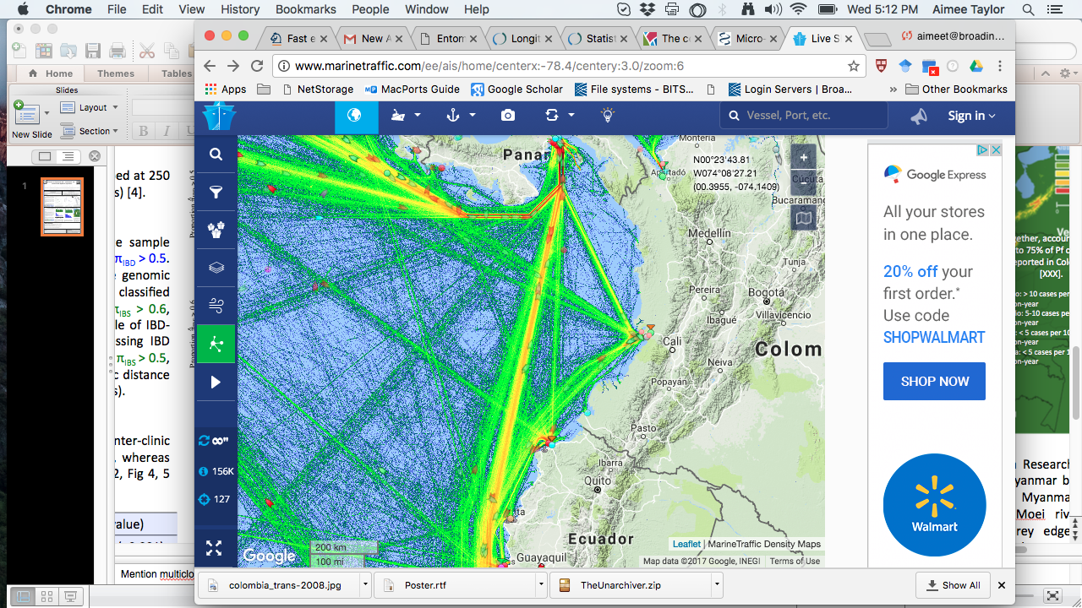
Genetic connectivity is associated with marine traffic
www.marinetraffic.com
Ports
Notes:
Now, it just so happens that Tumaco and Buenaventura are the only two ports on the Colombian Pacific coast.
As highlighted here on the right in a screen shot from marine traffic dot com, where these green lines over the water depict the frequency of marine traffic
This lead me to question whether Tumaco and Buenaventura, though far apart in space are close together in terms of travel time.
To test this hypothesis, my collaborators have gathered travel time estimates directly from the the sites
Vladimir
Guapi to Buenaventura: fast boat, 6-8 ppl, 4 hr; ship cargo, approx. 50 ppl, 12hr;
Tumaco road is a bad road
no public transport between Guapi and Tumaco, only contract fast boat; 1 hr to El Charco (just south of Guapi) and 5hrs from El Charco to Tumaco.
plantain produced in Tumaco is sold in Guapi (and probably Buenventura)
many goods that are received in Buenaventura (the major port of Colombia) are delivered to Tumaco
Diego
By Ship (barco): price: around 80.000 – 100.000 COP (1 USD is 3050 COP)
- Tumaco – Buenaventura: about 17-18 hours.
- Guapi – Buenaventura: about 10 – 12 hours
By Boat (lancha): price around 120.000 COP
- Buenaventura – Guapi: 4h
- Guapi – Tumaco: 3 – 3,5 H
Buenaventura-Tumaco: No transportation. the sea rout is Buenaventura-Guapi and them Tumaco (and Vice-versa). A express transportation with good accommodation, food, Buenaventura-Guapi-Tumaco may cost up to 4.000.000 COP.
- Road trip Between Guapi and the Panamerican freeway (the blue road in the map): No access at all.
The only inter-municipal road in Guapi es between Guapi (Cauca) and Chanzara (Narino), it is a rudimentary and dangerous way, about 2 hours. People do no use this road.

Slide 17
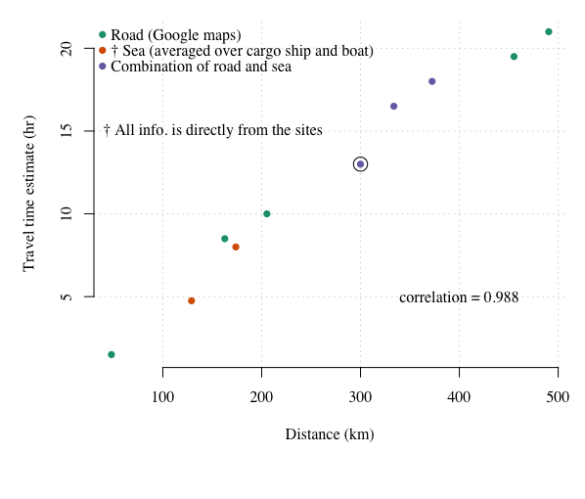
Travel time correlates with geographic distance
Unpublished
Buenaventura and Tumaco
Notes:
The travel time estimates are shown here on the vertical axis plotted against distance
To my surprise, there is almost perfect correlation between travel time and distance
The travel time between Buenaventura and Tumaco does not explain the signal seen in the genetic data

Slide 18
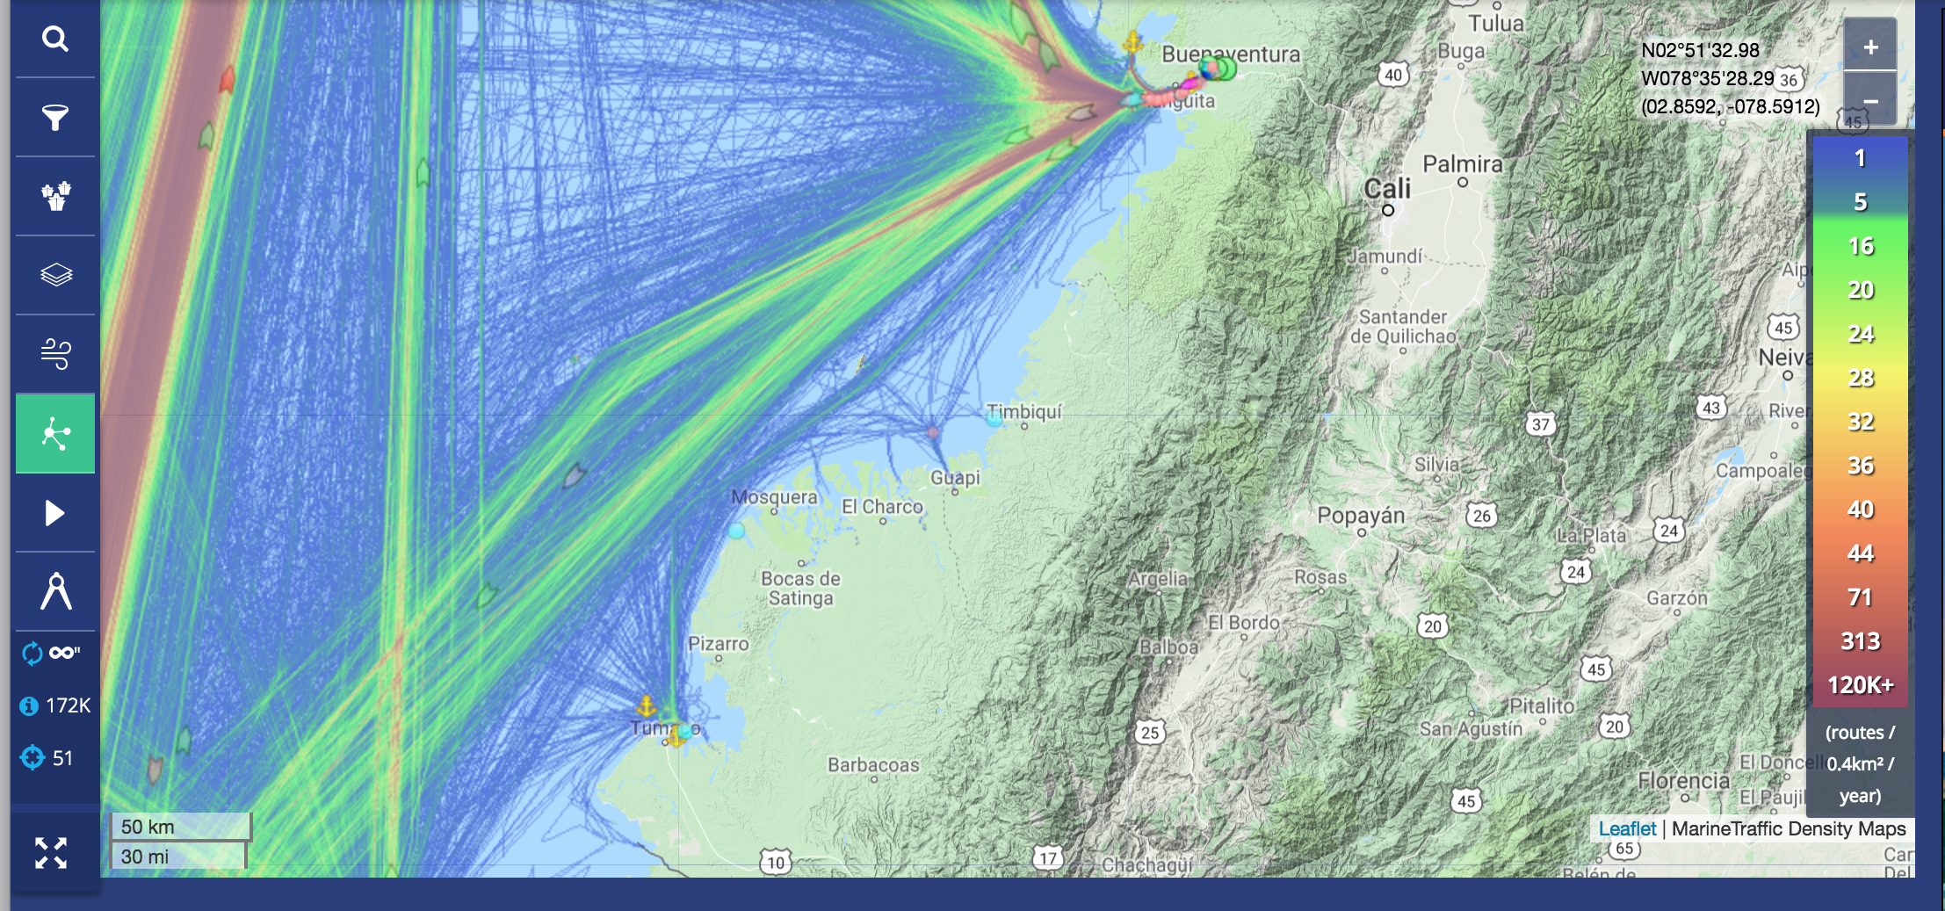
Travel frequency correlates with genetic signal between ports
www.marinetraffic.com
Tumaco and Buenventura: approx. 16 routes per 0.4 km² per year
Guapi and Buenaventura or Tumaco: approx. 1 route per 0.4 km² per year
Notes:
However, a second look the marine traffic data
Paying particular attention to the legend shown here on the right-hand side
with approximately 16 more routes per year between Buenaventura and Tumaco as compared to Guapi, which is here in the middle
suggests the frequency of travel between these two sites correlates with the genetic signal,

Slide 19




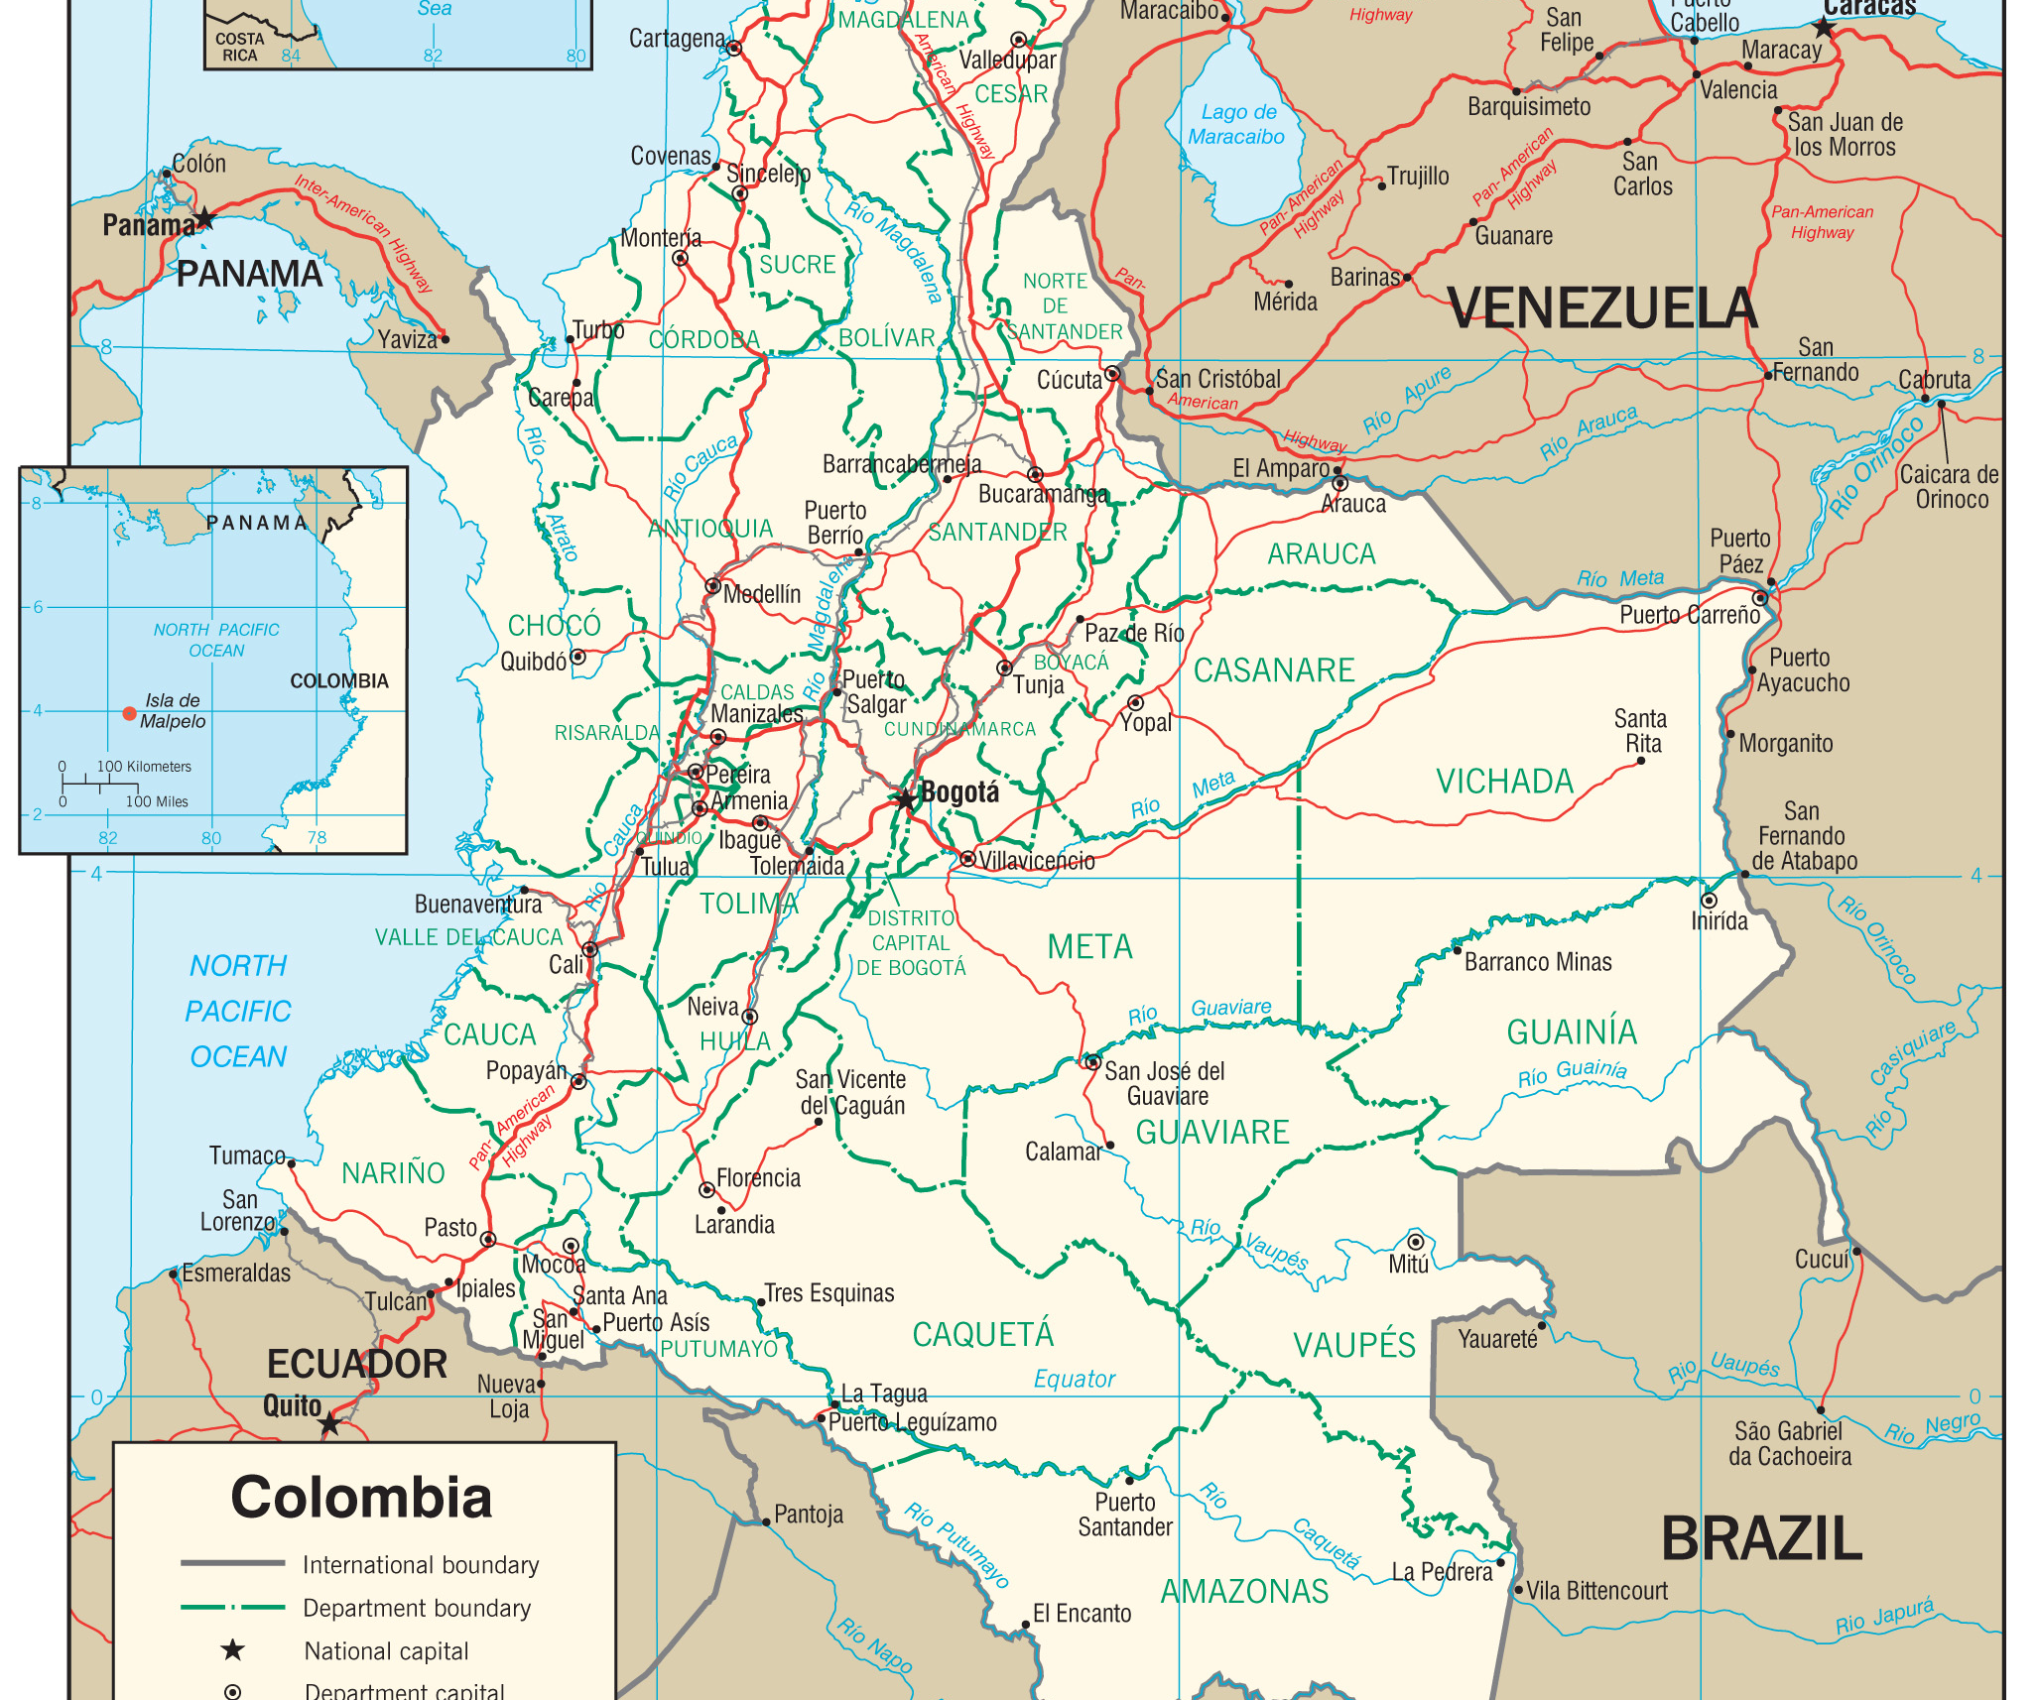
Summary
There is evidence of connectivity and spatial-temporal trends in relatedness
Buenaventura and Tumaco are disproportionally connected
Marine travel frequency (versus time) is associated with port connectivity
Is transmission mediated by people or mosquitoes and can we interrupt it?
Notes:
In summary, there is evidence of connectivity and spatial-temporal trends between falciparum parasite populations on the Colombian Pacific coast
Which has implications for the design of targeted interventions
We find that the tow ports on the coast are disproportionally connected, suggesting marine travel make contribute to transmission
Which raises questions, Is transmission mediated by people or mosquitoes and can we interrupt it?

Slide 20
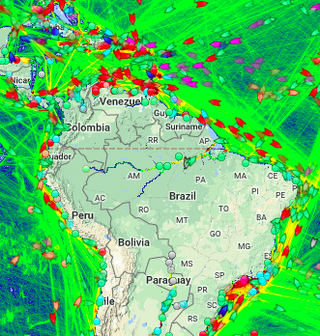
Next steps
Does marine traffic impact malaria transmission more generally?
Prospective data
Probabilistic gravity model, combining complementary data
Notes:
It also raises questions about the contribution of marine traffic to transmission elsewhere
We hope to analyses prospective data to explore this question,
potentially using a gravity model to capture the frequency of travel between sites,
and combining complementary data to build a fuller picture of transmission
This is essentially a hypothesis generating. Marine traffic could be a very important source of many types of transmission and previously overlooked contributor to the malaria eco system

Slide 21





Thank you!
Diego F. Echeverry
Timothy J. Anderson
Daniel E. Neafsey
Caroline O. Buckee
Vladimir Corredor
Luisa Rubiano
Angelica Knudson
Jesyd Salamanca
Notes:
With that I would like to thank you all for listening
Thank my co-authors, especially my postdoctoral advisors Daniel Neafsey and Caroline Buckee
And thank all those who helped to gather the travel time estimates from the sites
Can not rule out the possibility that the signal of connectivity between Buenaventura and Tumaco is due to common connectivity to somewhere else, say Panama or Ecuador. However, transmission is very low in both these places. Moreover, the point of this exercise is this generates a hypothesis, which if proved true could be addressed to interrupt transmission.

Slide 22
Observed (sampled)
Site A
Genetic connectivity
Site B
Time

Slide 23
Observed (sampled)
Present but not observed (not sampled, e.g. asymptomatic)
Site A
Genetic connectivity
Site B
Time

Slide 24
Observed (sampled)
Present but not observed (not sampled, e.g. asymptomatic)
Site A
Genetic connectivity
Site B
Time

Slide 25
Observed (sampled)
Present but not observed (not sampled, e.g. asymptomatic)
Site A
Genetic connectivity
Site B
Time

Slide 26
Observed (sampled)
Present but not observed (not sampled, e.g. asymptomatic)
Site A
Genetic connectivity
Site B
Time

Slide 27
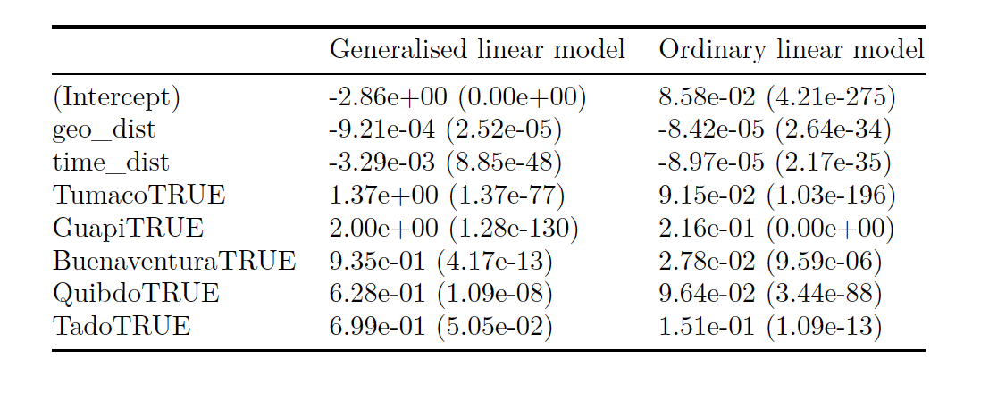
Trends in pairwise relatedness with both space and time
Fit to highly related versus not
Fit to r estimates directly
Unpublished

Slide 28
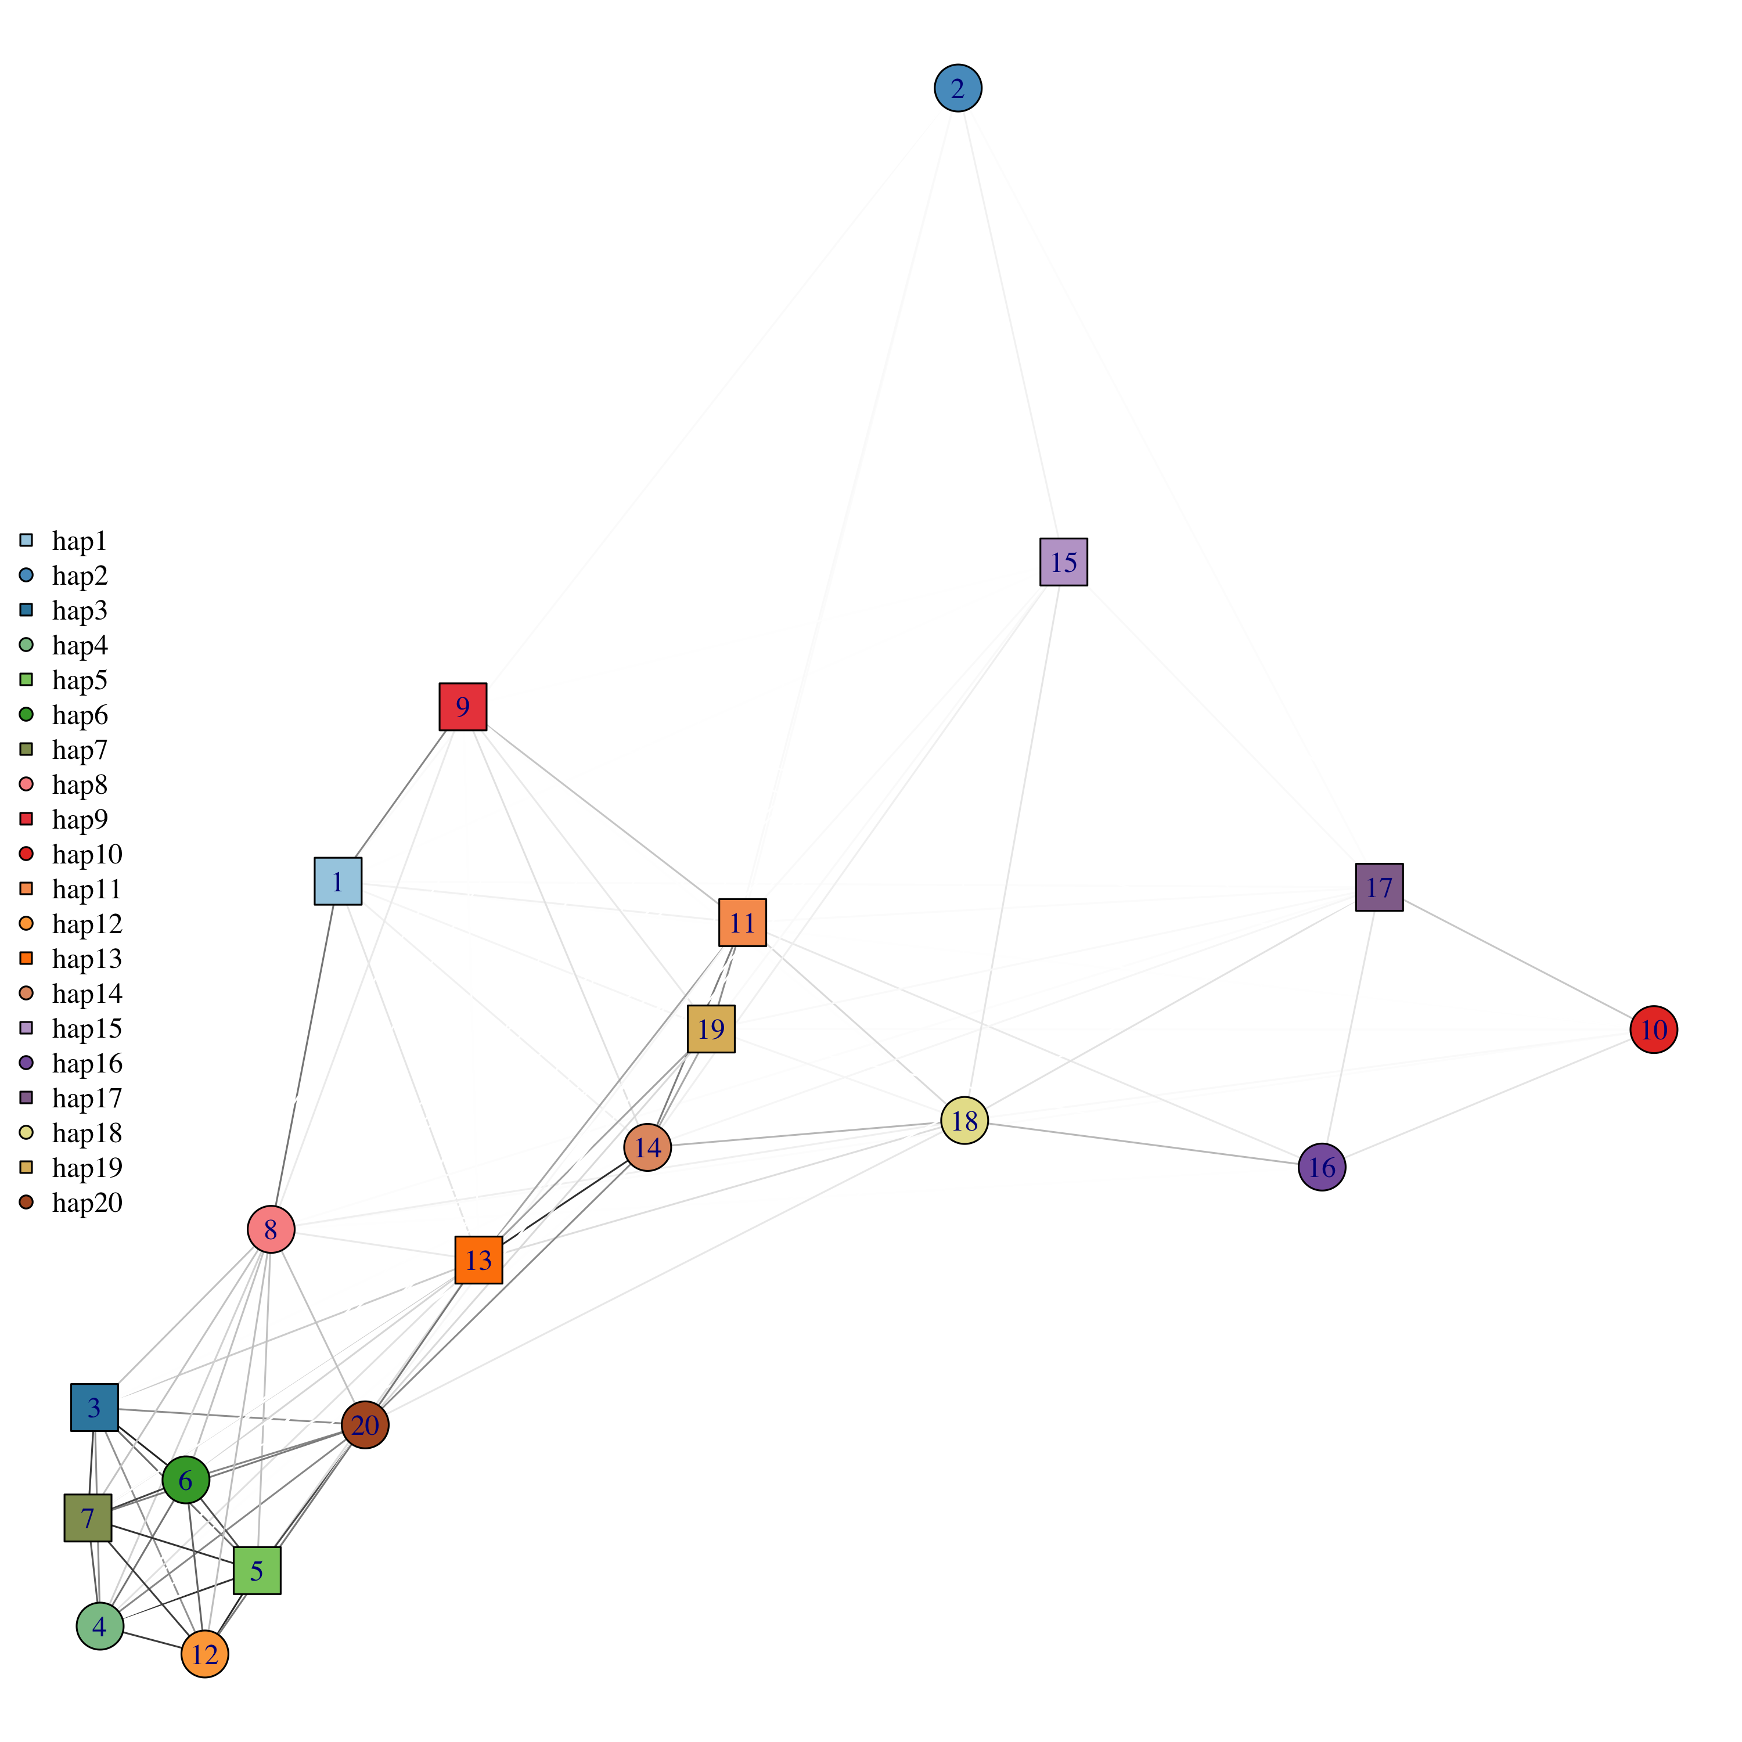
Are the repeat “haplotypes” highly related to one-another?
Some, not all
Edges = r estimates
Unpublished
Notes:
Range 0 to ~0.83

Slide 29
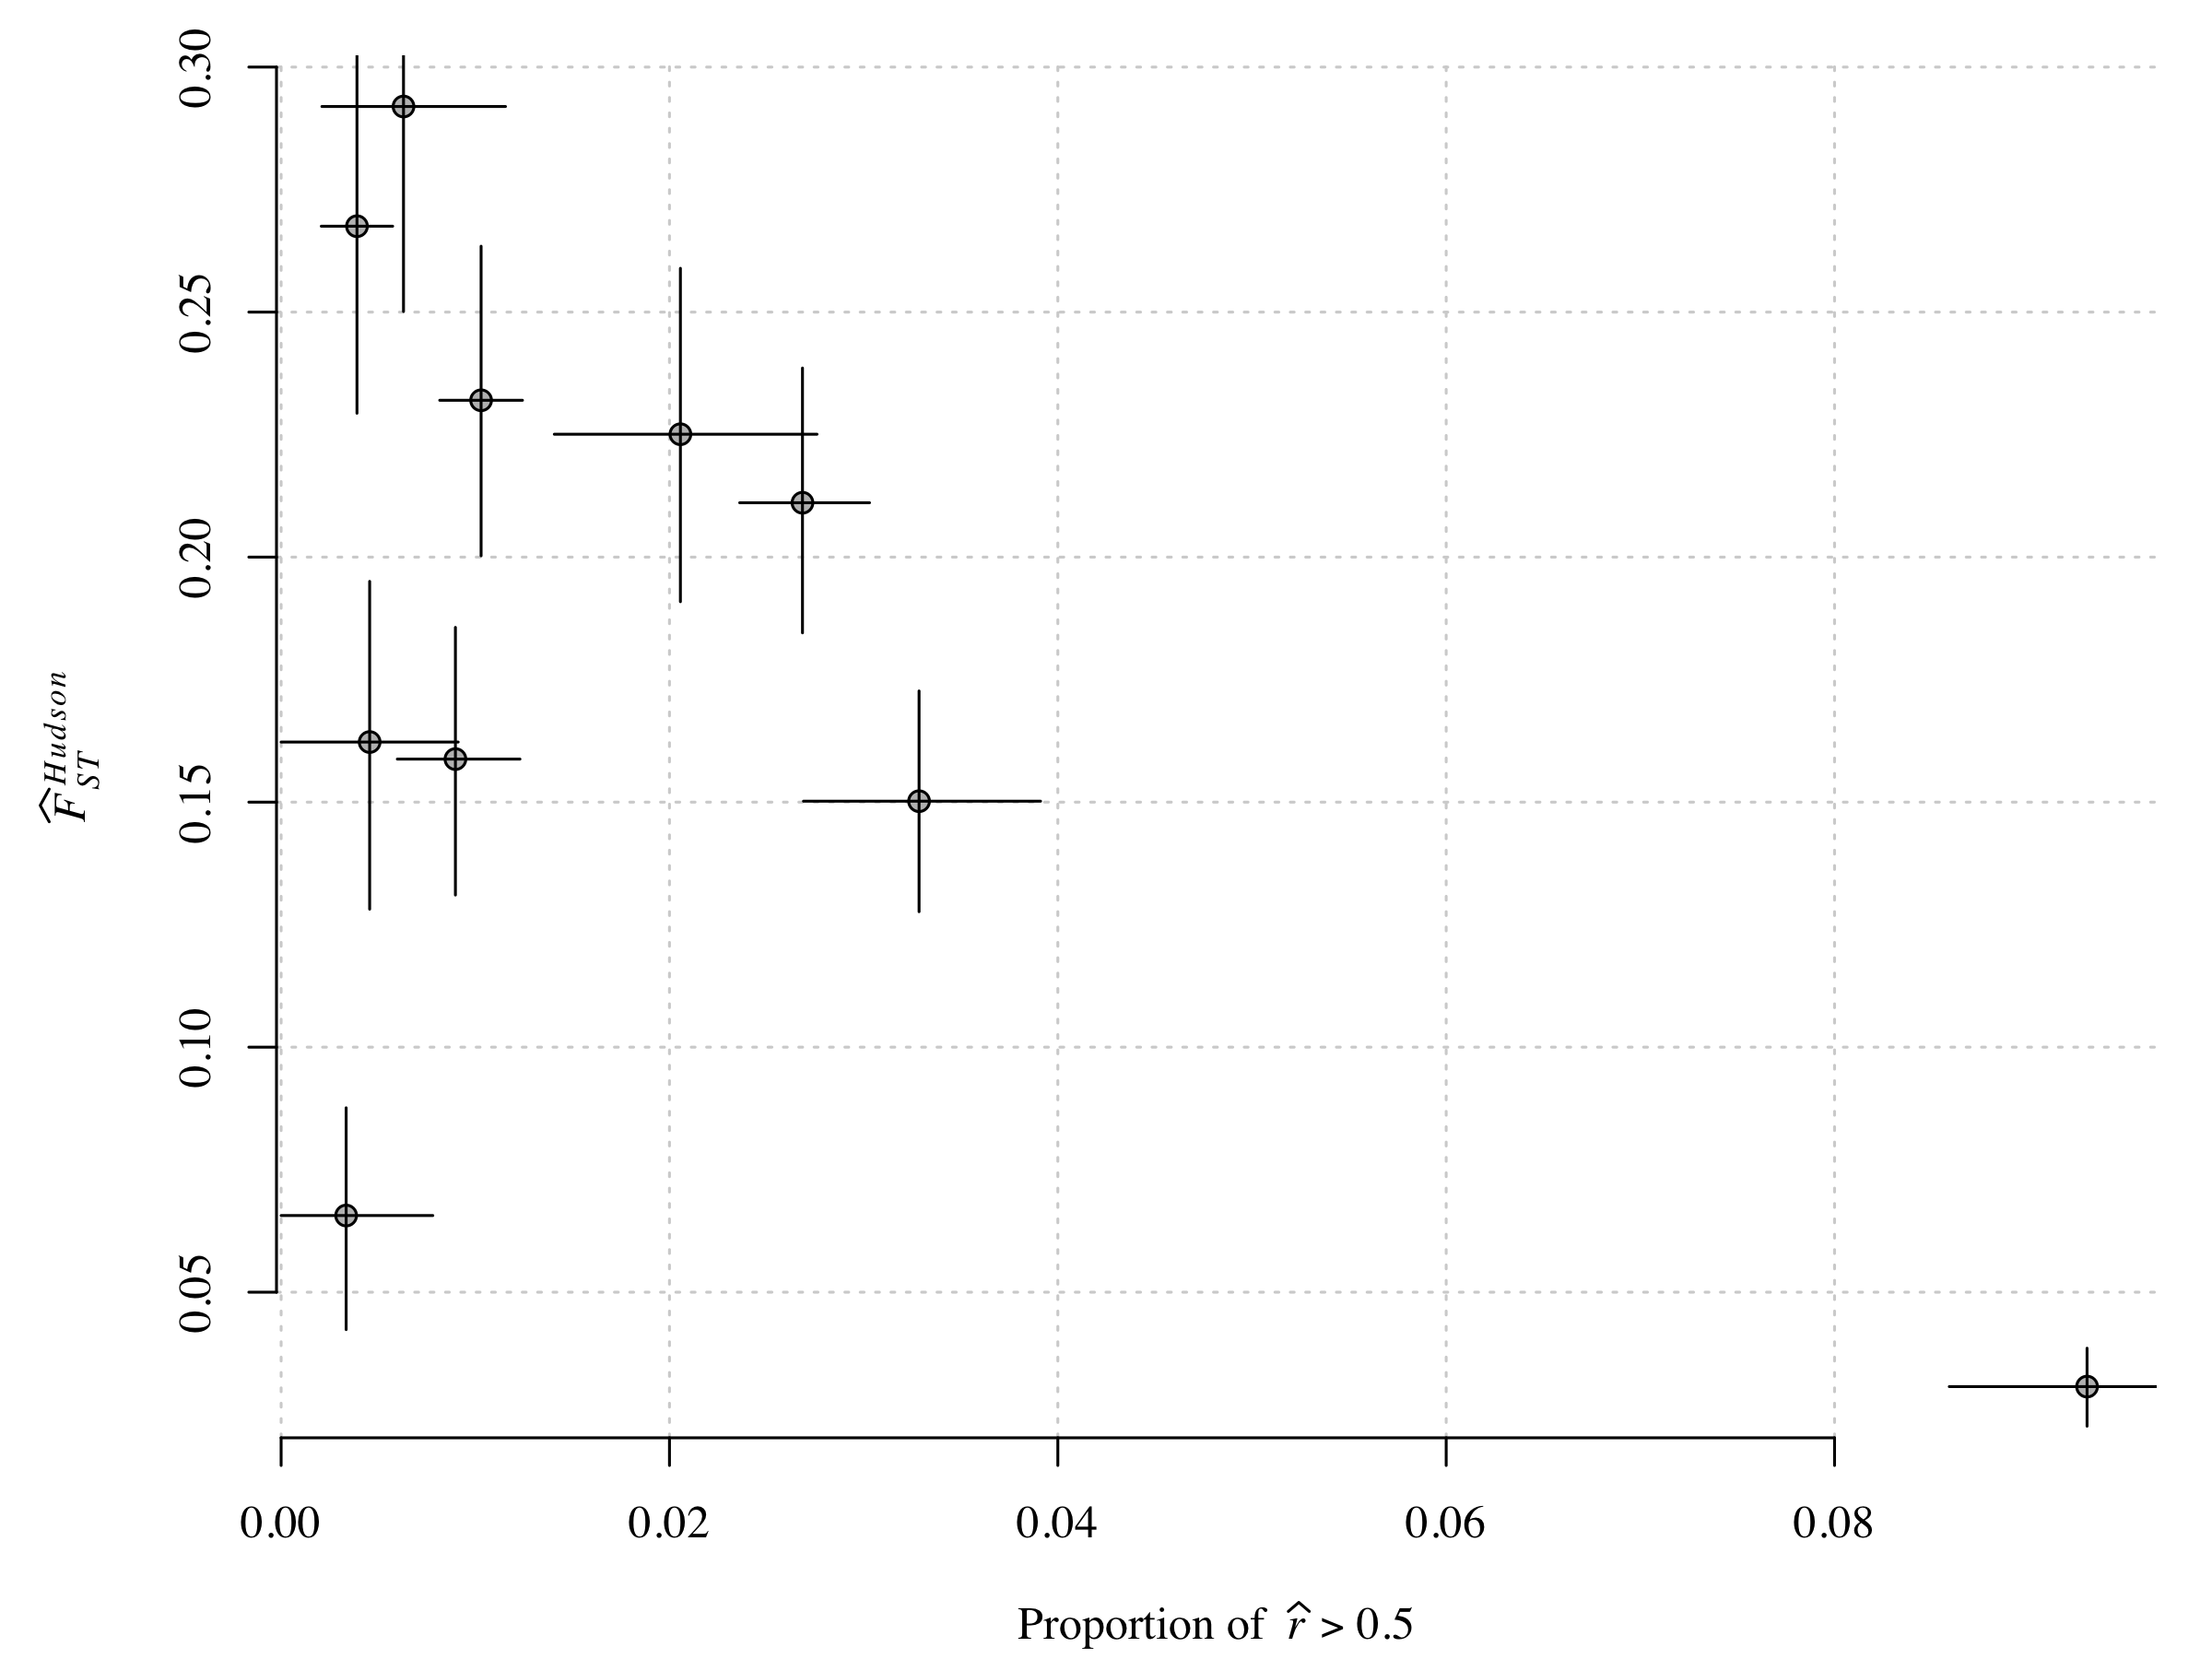
Previously published F_{ST} analyses agree

Slide 30
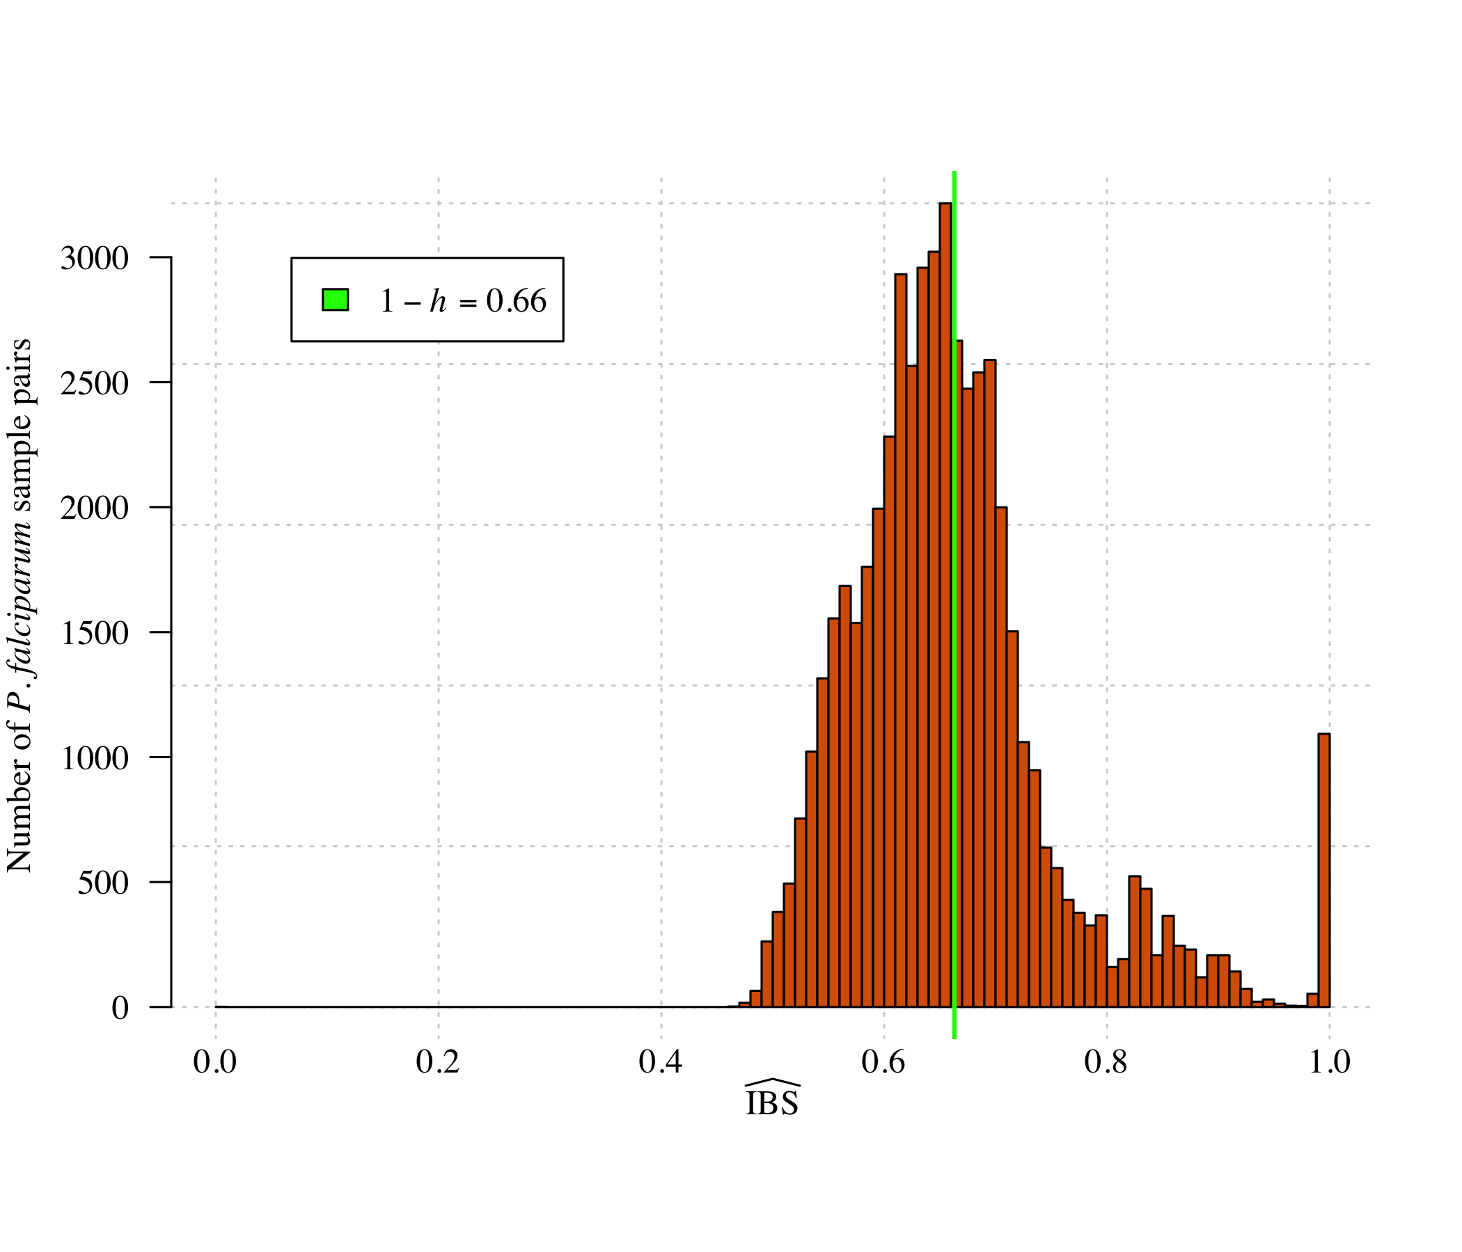
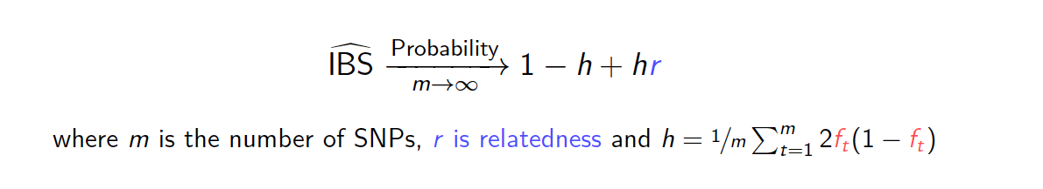
Aside: identity-by-state (IBS) estimates generate similar results despite vastly different distribution
m = number of SNPs
r = relatedness
h = function of allele frequencies
Unpublished
Notes:
IBS threshold requires knowledge of IBD

Slide 31
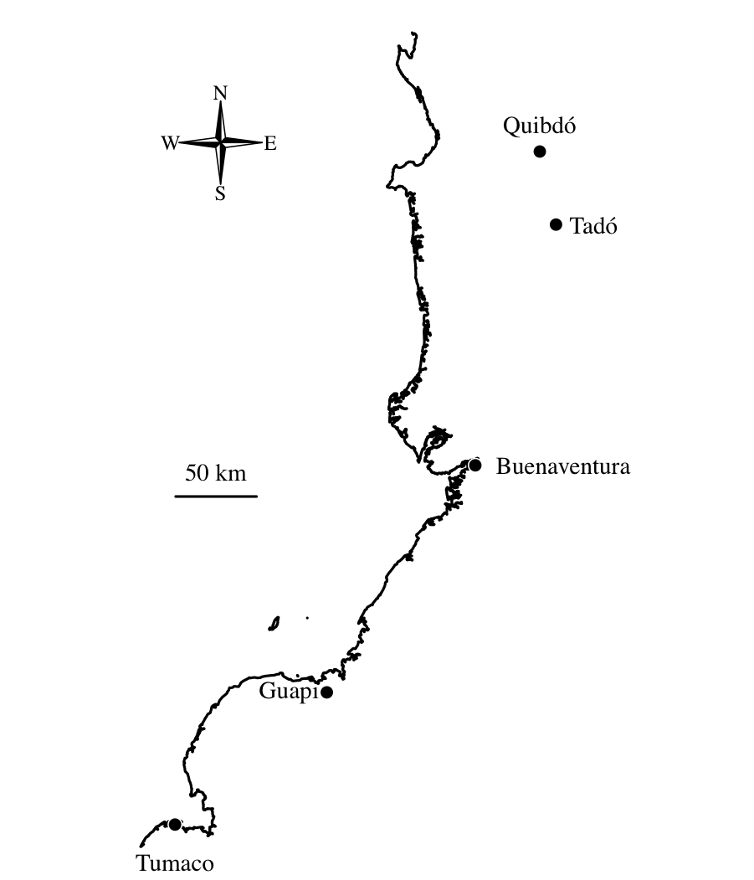
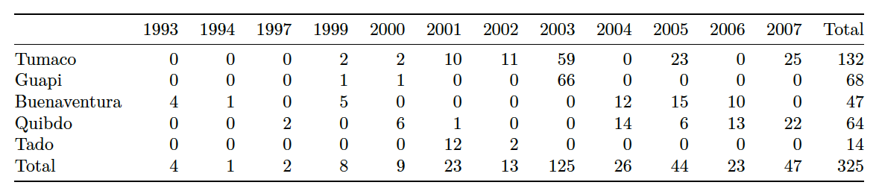
Previously published P. falciparum data from the Colombian Pacific Coast
325 single-genotype parasite samples collected between 1993 and 2007 and genotyped at 250 single nucleotide polymorphisms (SNPs)
Echeverry,D.F. et al. (2013) BMC Genet.

Slide 32
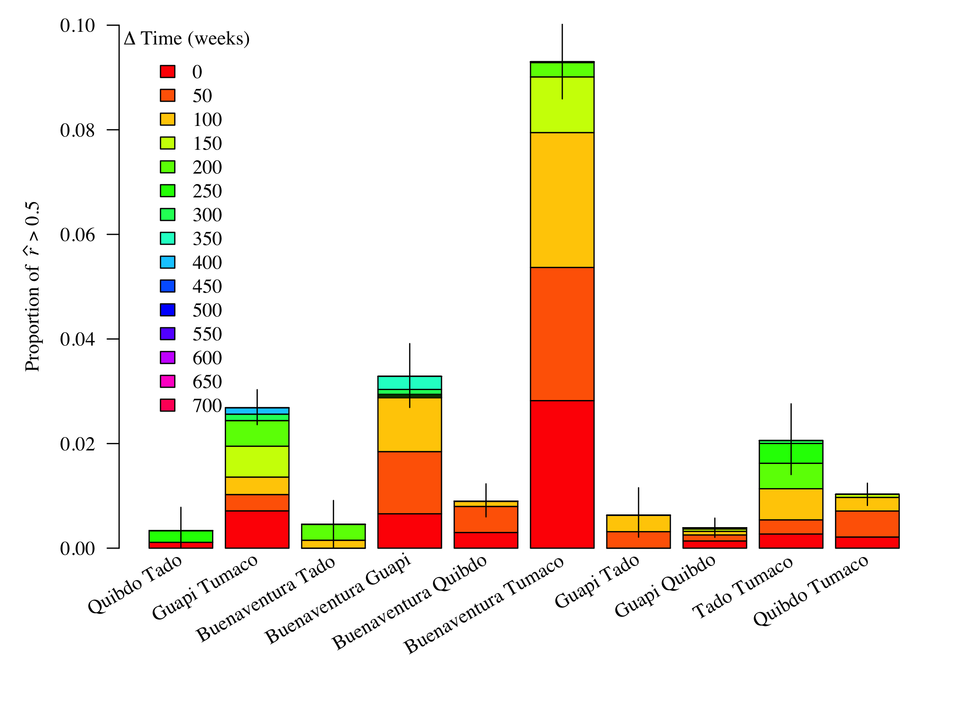
Connectivity across sites is not explained away by time
Unpublished

Slide 33
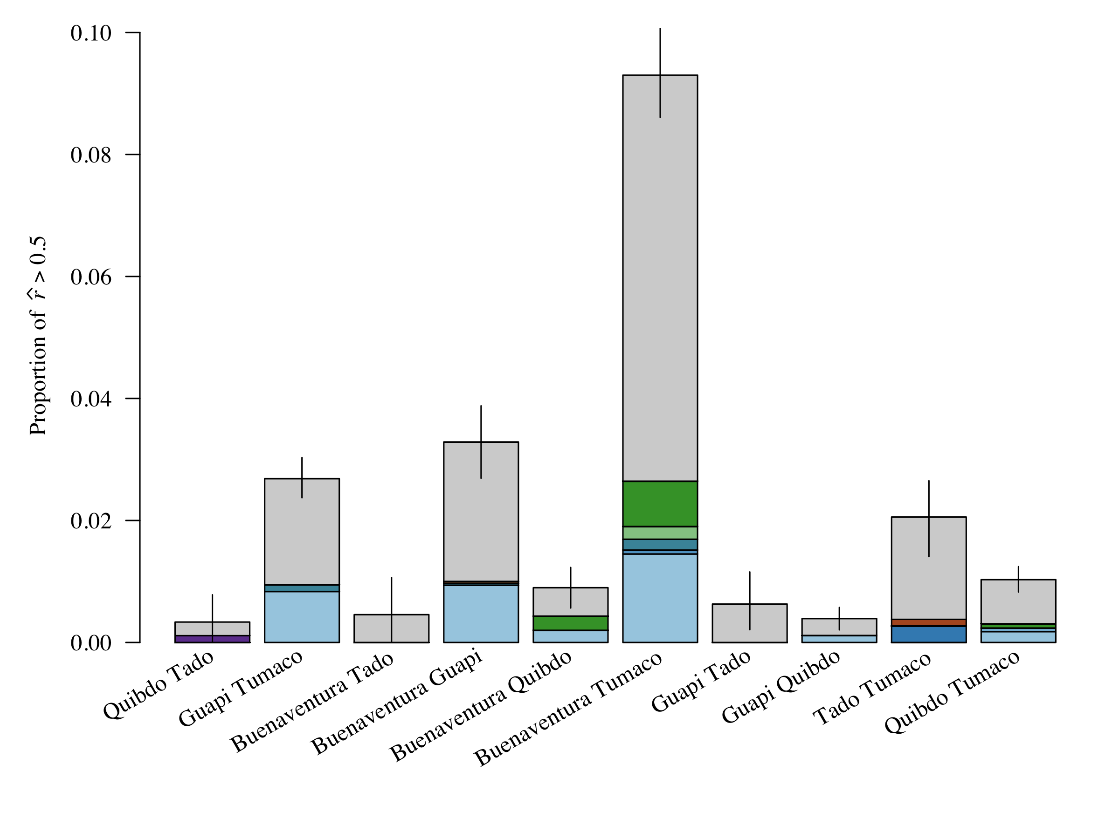
A closer look into the genetic links between ports
Connectivity across sites is not explained away by a single clone
Unique 250-SNP haplotype:
Repeat 250-SNP haplotype: etc.
Given that more than 80% of samples originally collected by Echeverry et al. were monoclonal, diversity is unlikely the result of a
one-time travel event across sites
Notes:
Given that over 80% (81%) of the collected it seems unlikely
Given these are all single-genotype
Colored if a repeat “haplotype”. Solid: rhat > 0.5; dashed: rhat ≤ 0.5
Given MOI distribution (look to paper), unlikely a one-time source-sink event
I explored allowing 1:20, 4 to 15 were stable.
How much relatedness does that correspond to?
How different would it be if I only allowed 0 differences?
Haps 1 and are not highly related, but 12 is related to 4:7
The fact that there are multiple repeat haplotypes suggests gene flow was not a one-time event. The fact that each site has some private repeat haplotypes suggests that there is potential for two-way flow.
The number of differently coloured repeat haplotypes might give a false impression of the number of independent pieces of information, however.
Of the haplotypes shared across Buenaventura and Tumaco, haplotypes 5, 7 and 12 are all highly related to one another, so might originate from a single parasite. On the contary, haplotypes 1 and 2 are not highly related to the above cluster nor one-another. Together these results suggest three travel events.

